Slide 1
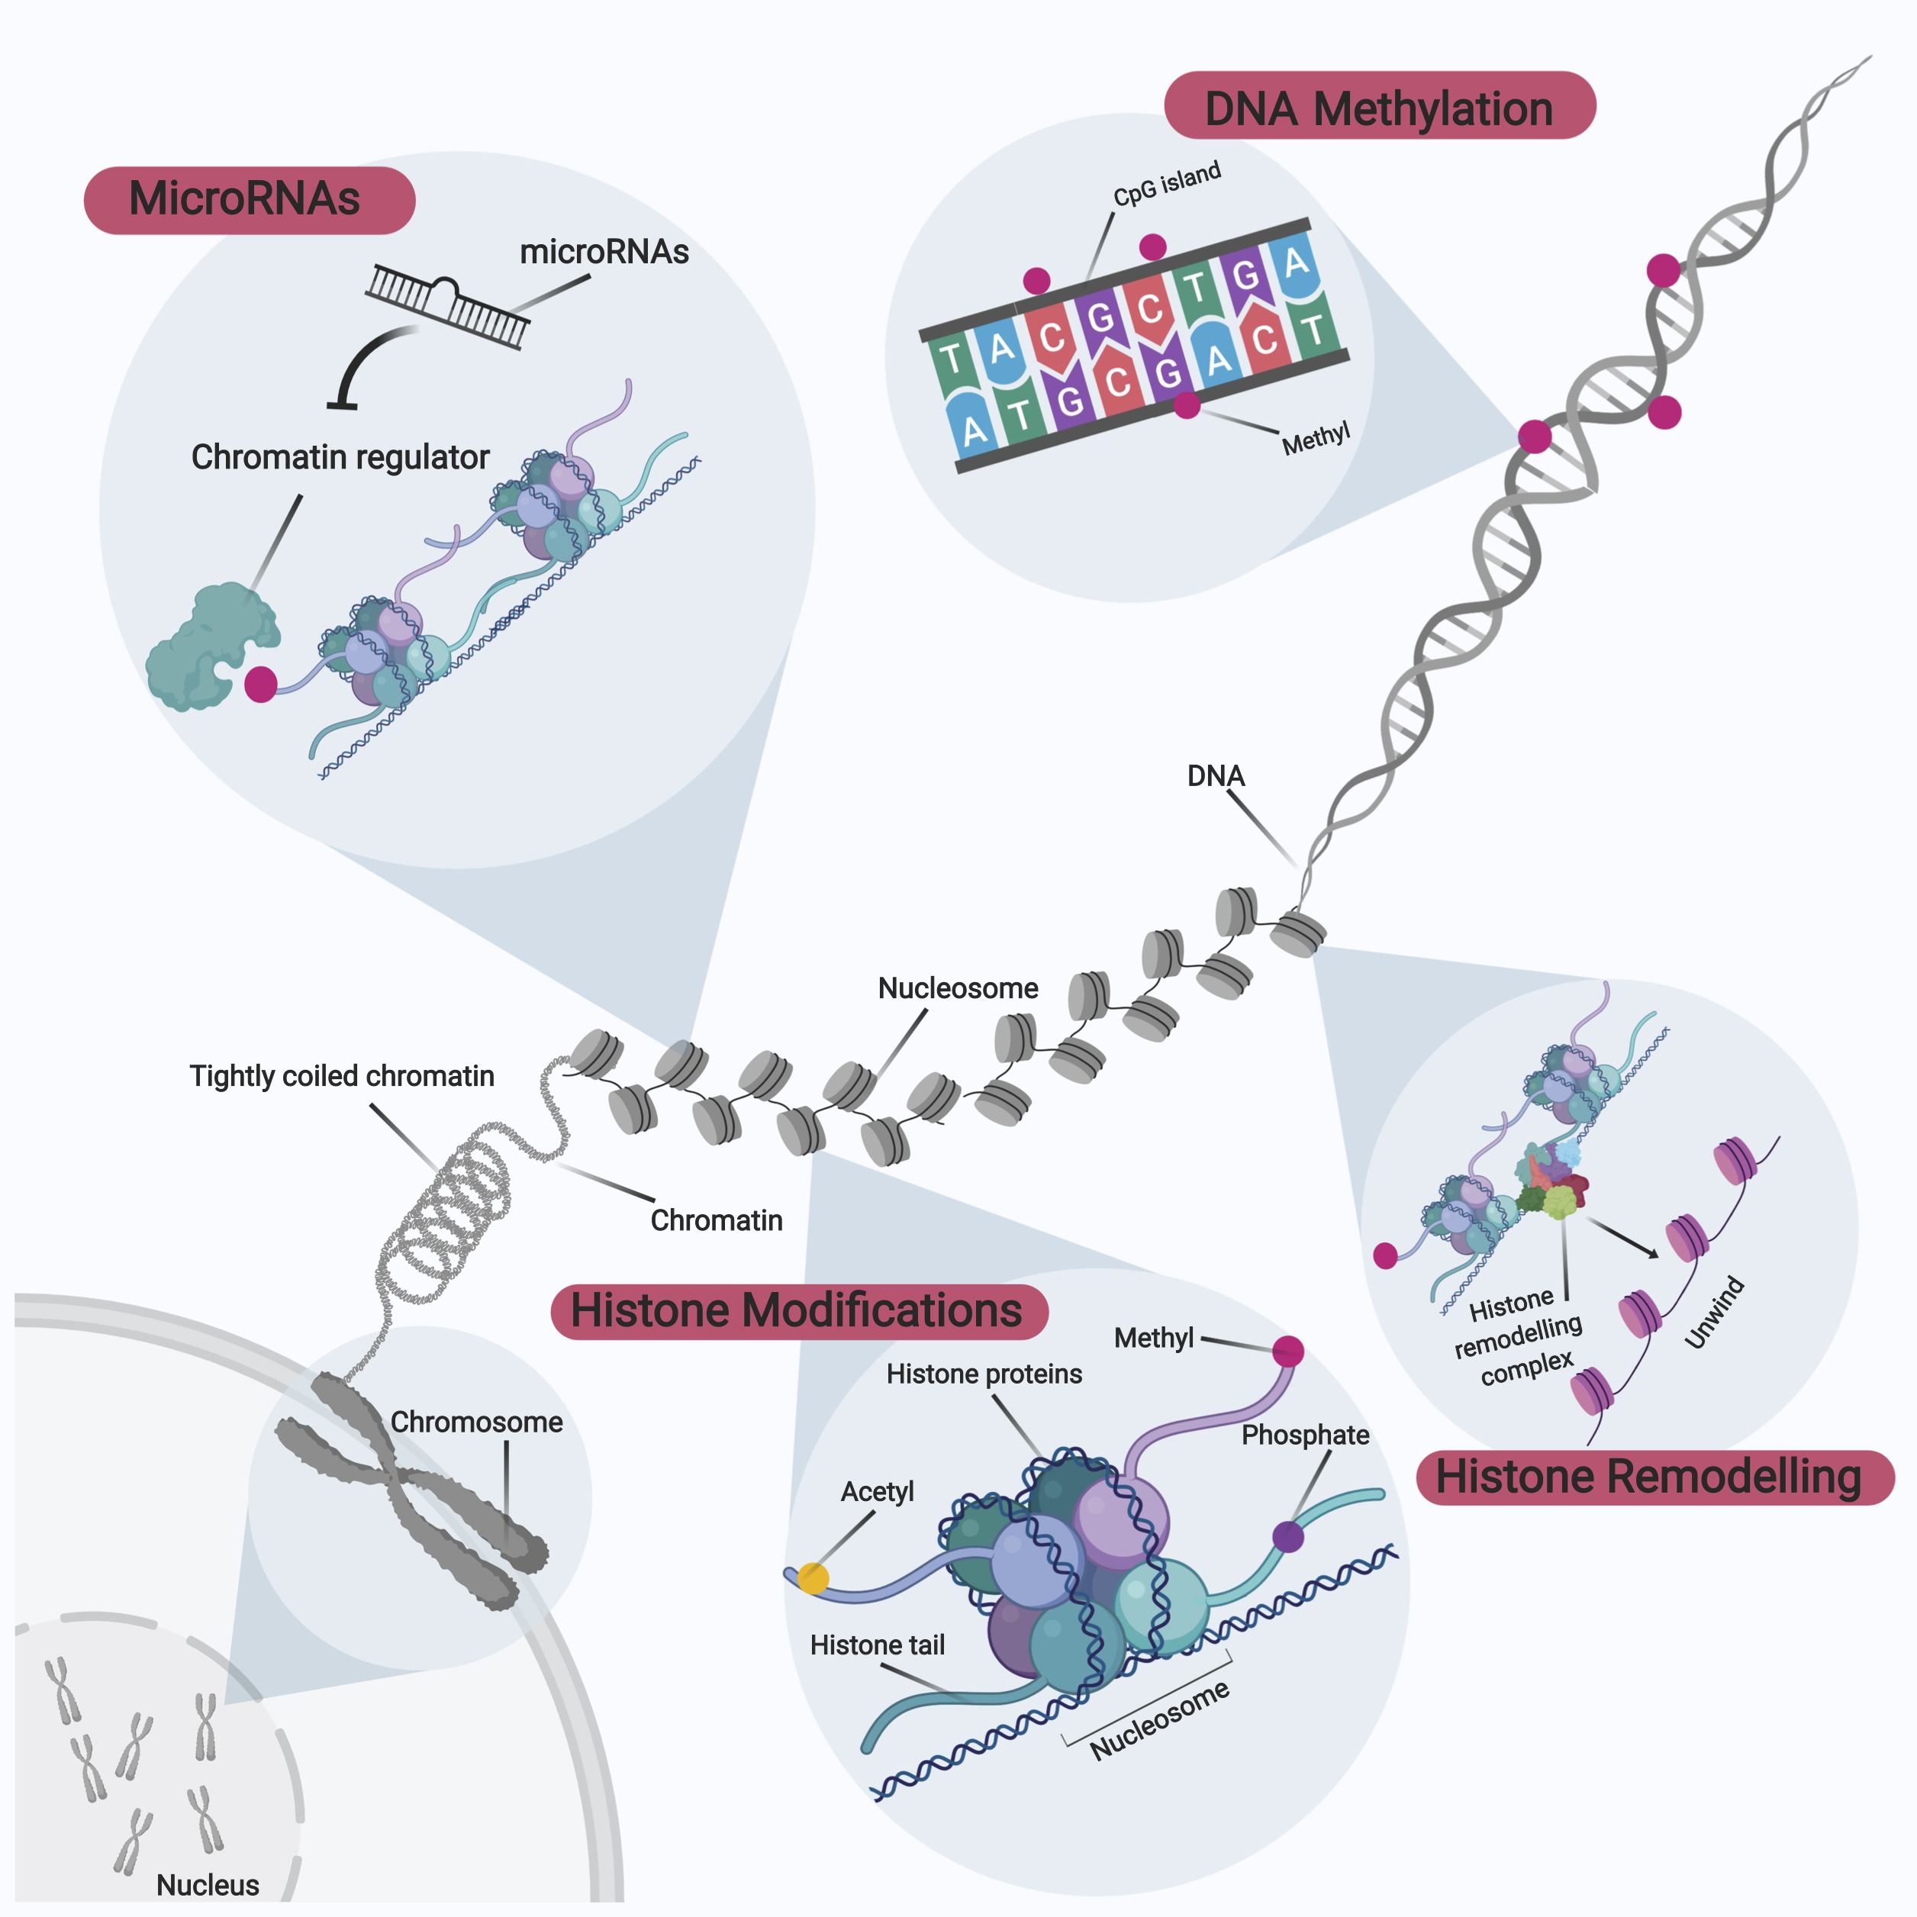
Figure 4. Overview of Epigenetic Modifications.
Gavin Yong-Quan Ng et al., Conditioning Medicine 2019; 2(6):284-299.

