Slide 1
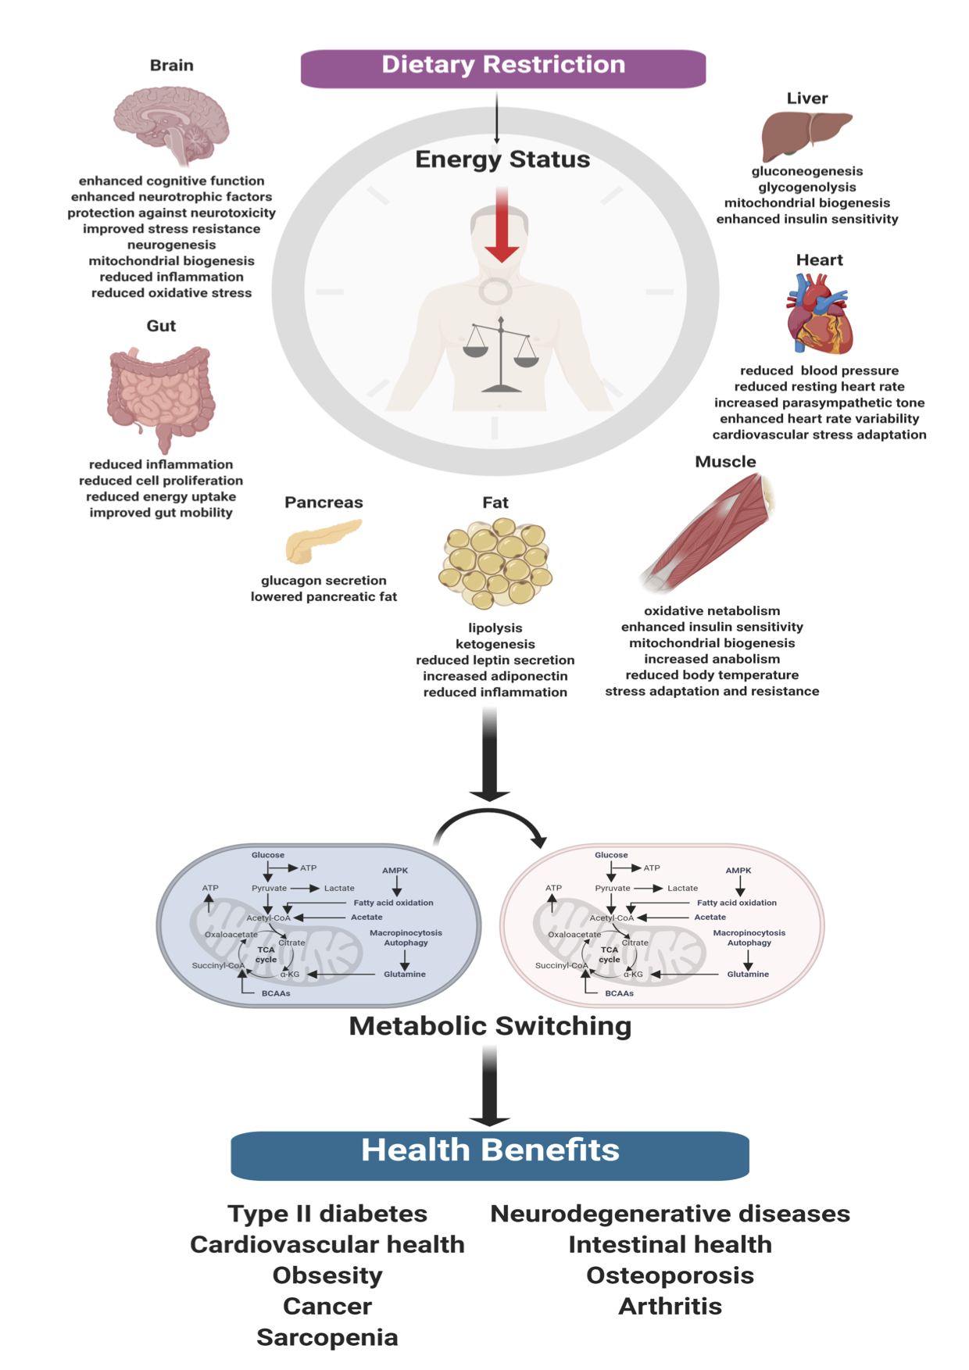
Figure 3. Effects of Dietary Restriction. DR can induce a myriad of systemic effects.
Gavin Yong-Quan Ng et al., Conditioning Medicine 2019; 2(6):284-299.

