Slide 1
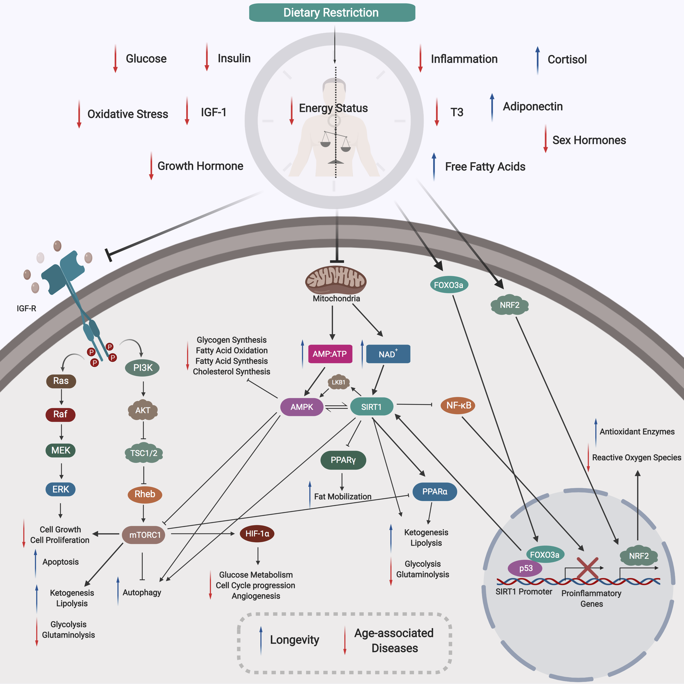
Figure 2. Mechanism of Dietary Restriction.
Gavin Yong-Quan Ng et al., Conditioning Medicine 2019; 2(6):284-299.

