Slide 1
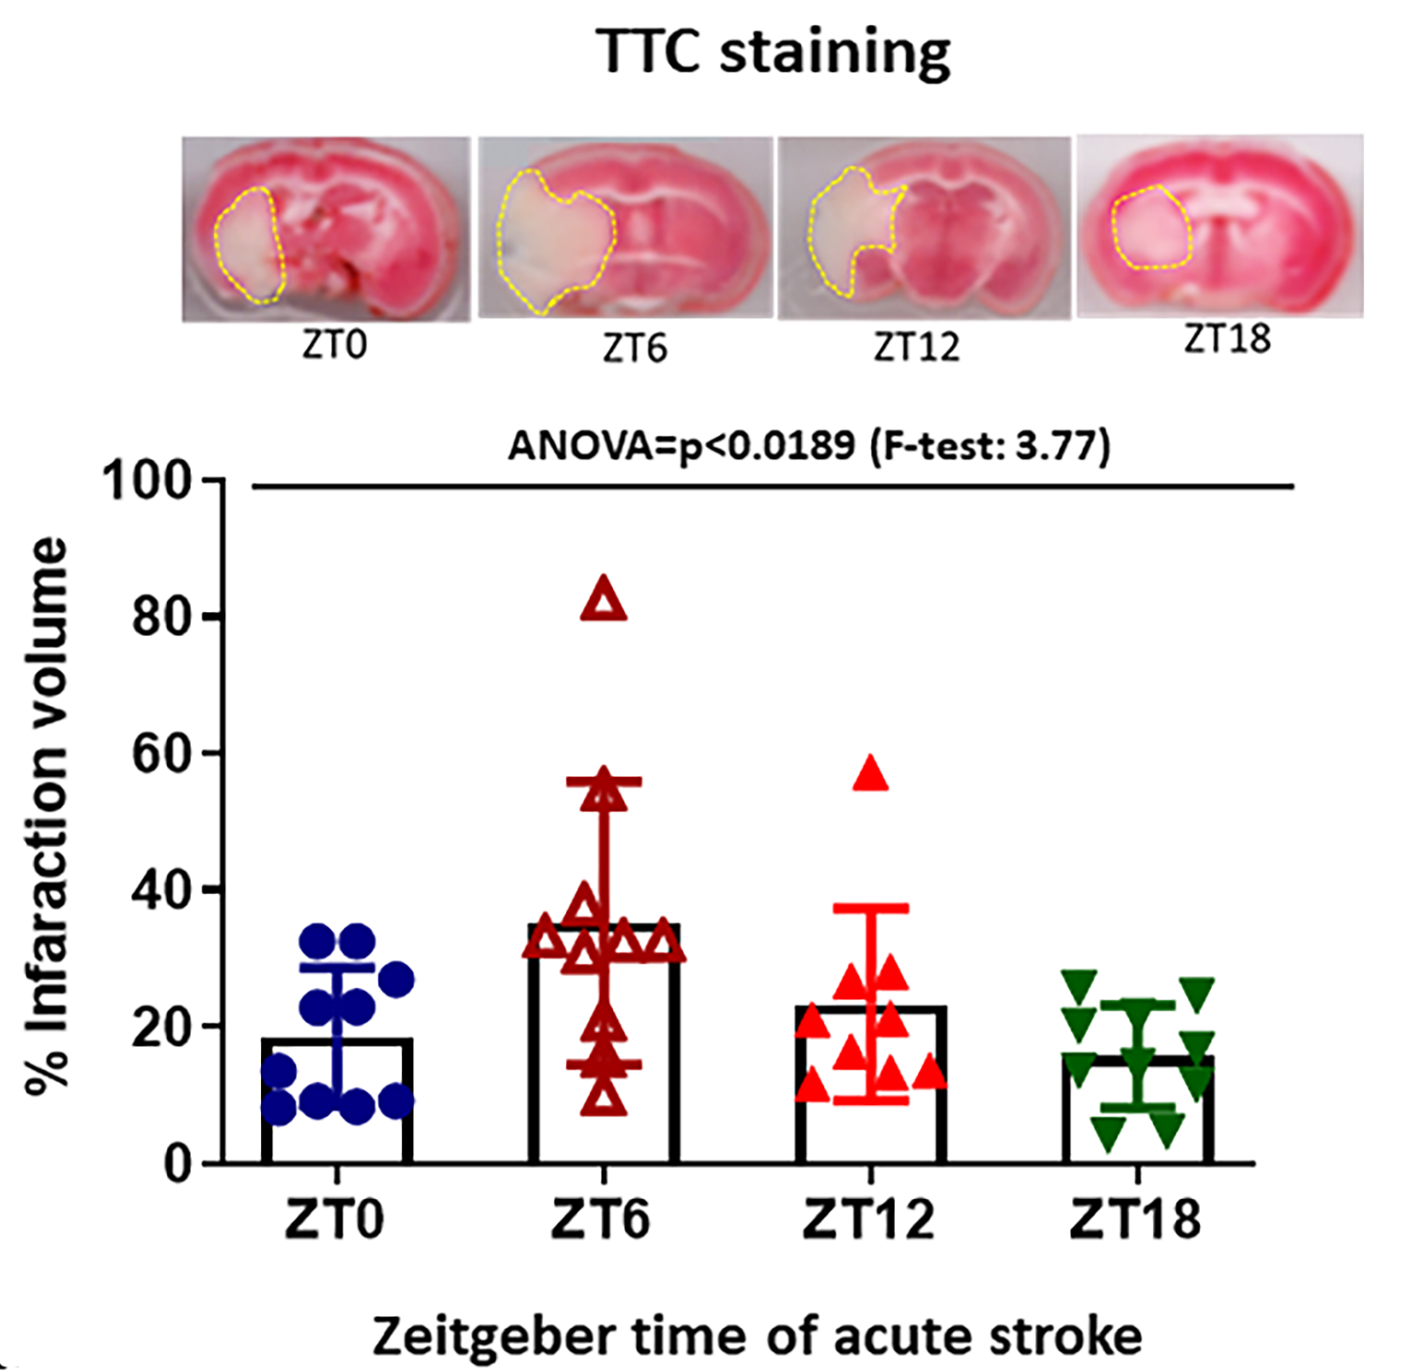
Figure 3. The infarct volume was observed by TTC staining of brain slices from each time points of stroke induction.
Kamat et al, Conditioning Medicine 2021; 4(6):280-284.

