Slide 1
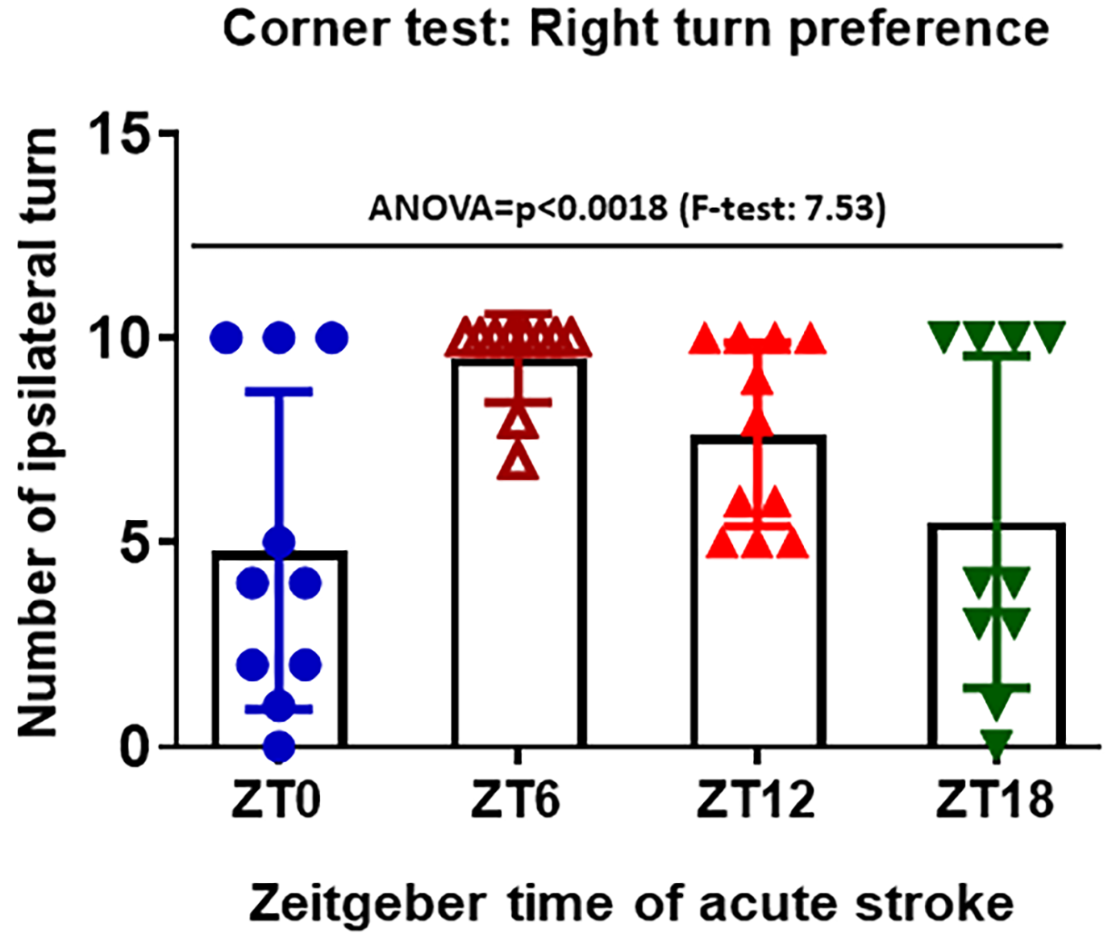
Figure 2. Corner test were performed to count right and left turn after stroke at 48hr of acute stroke.
Kamat et al, Conditioning Medicine 2021; 4(6):280-284.

