Slide 1
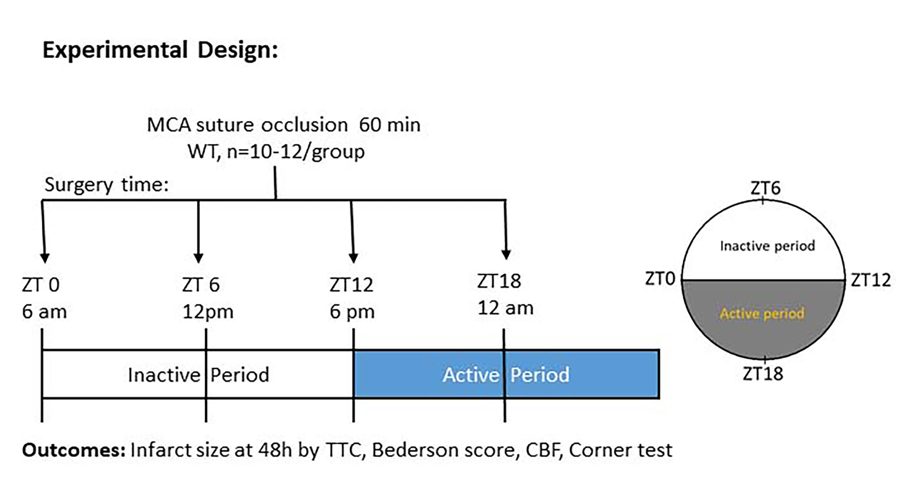
Figure 1. The schematic diagram of the experimental design.
Kamat et al, Conditioning Medicine 2021; 4(6):280-284.

