Slide 1
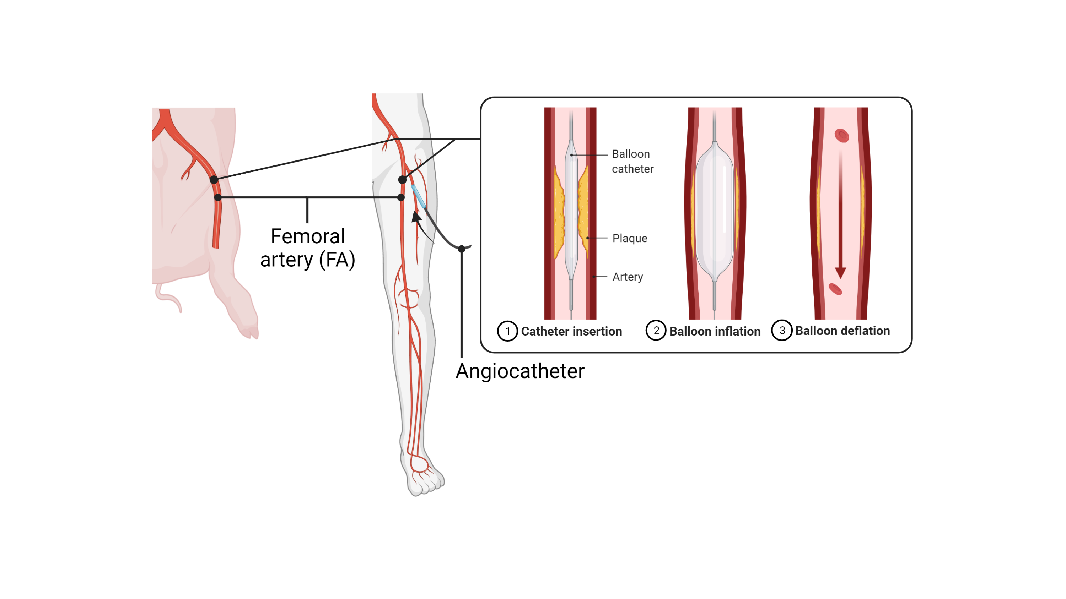
Figure 2. The murine femoral artery (FA) wire-injury model involves insertion of a wire into the FA to induce endothelial denudation.
Chua et al, Conditioning Medicine 2021; 4(5):209-215

