Slide 1
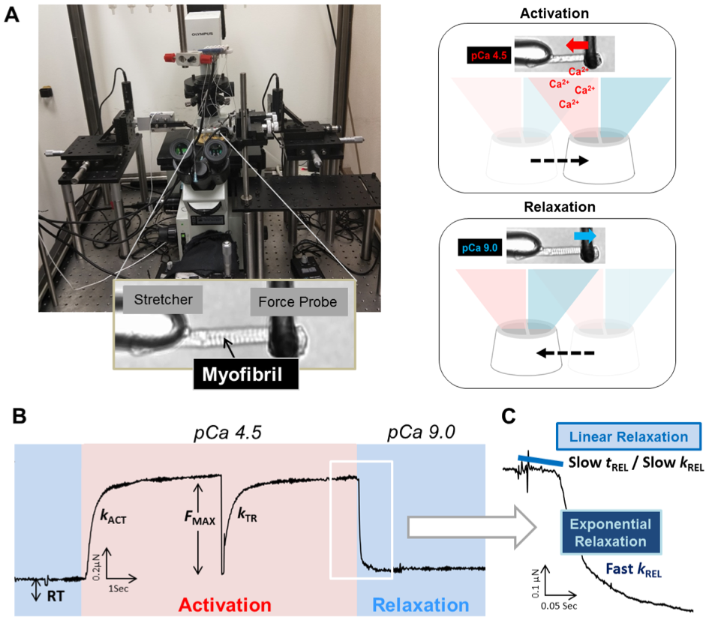
Figure 3. Myofibril mechanics rig and representative activation-relaxation cycle
Ying-Hsi Lin et al., Conditioning Medicine 2019; 2(5):213-224.

