Slide 1
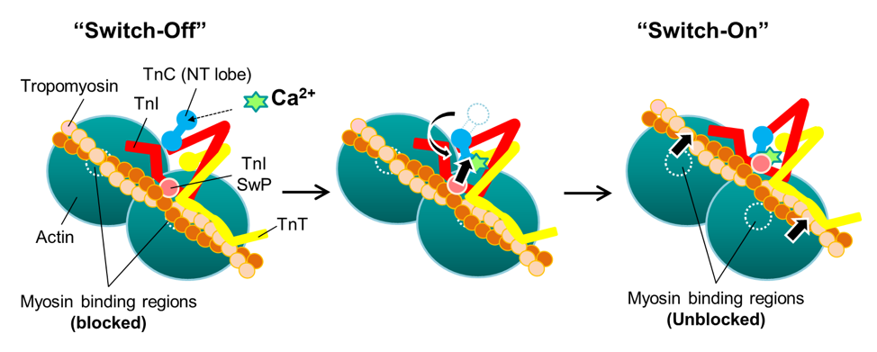
Figure 2. Scheme illustration of troponin complex structural changes in the transition from a relaxation to an active state.
Ying-Hsi Lin et al., Conditioning Medicine 2019; 2(5):213-224.

