Slide 1
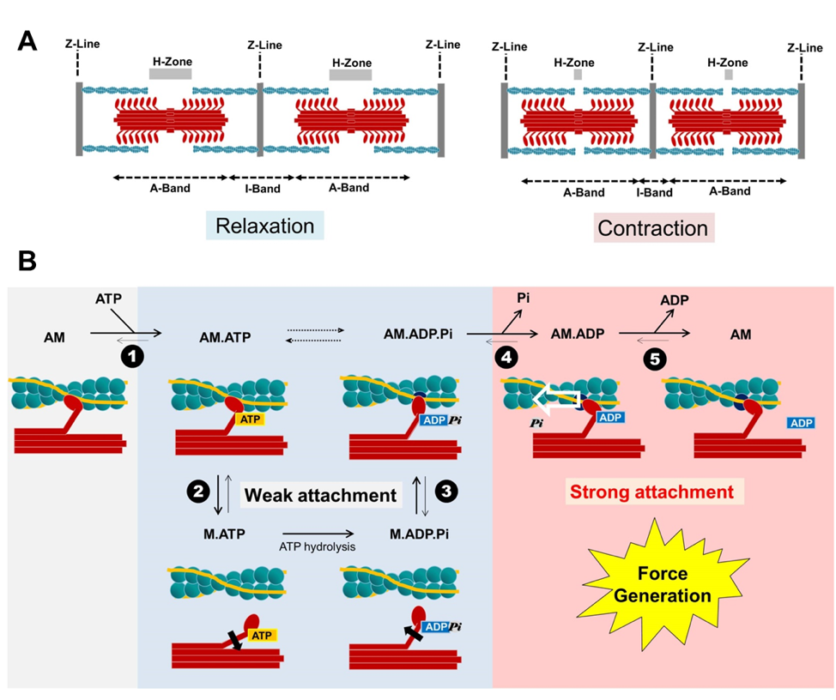
Figure 1. Sliding filament model of muscle contraction and the cross-bridge cycle.
Ying-Hsi Lin et al., Conditioning Medicine 2019; 2(5):213-224.

