Slide 1
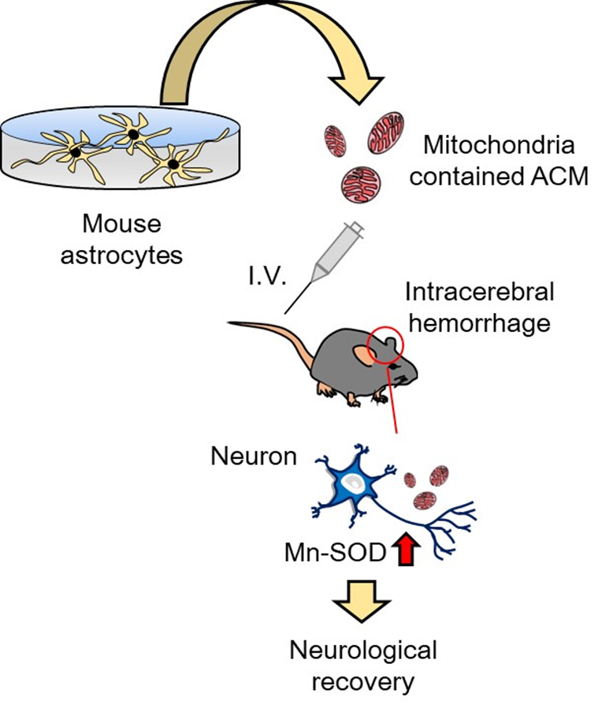
Figure 1.
Kazuhide Hayakawa, Conditioning Medicine 2022; 5(6): 192-195.

