Slide 1
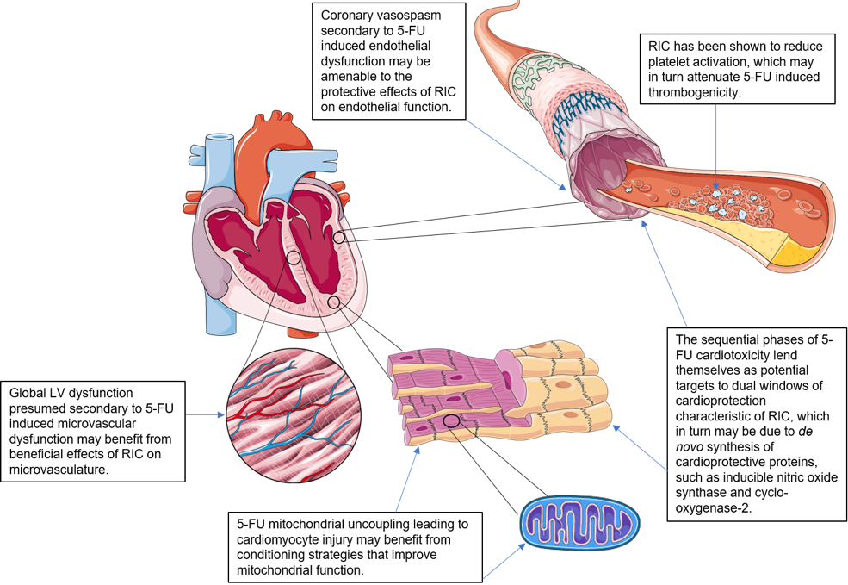
Figure 1. Potential cellular targets in 5-fluorouracil cardiotoxicity amenable to RIC cardioprotection.
*Image components courtesy of Servier Medical Art. Figure 1 (with annotations) is original work by first author with use of said image components.
Jun Chong et al., Conditioning Medicine 2019; 2(5):204-212.

