Slide 1
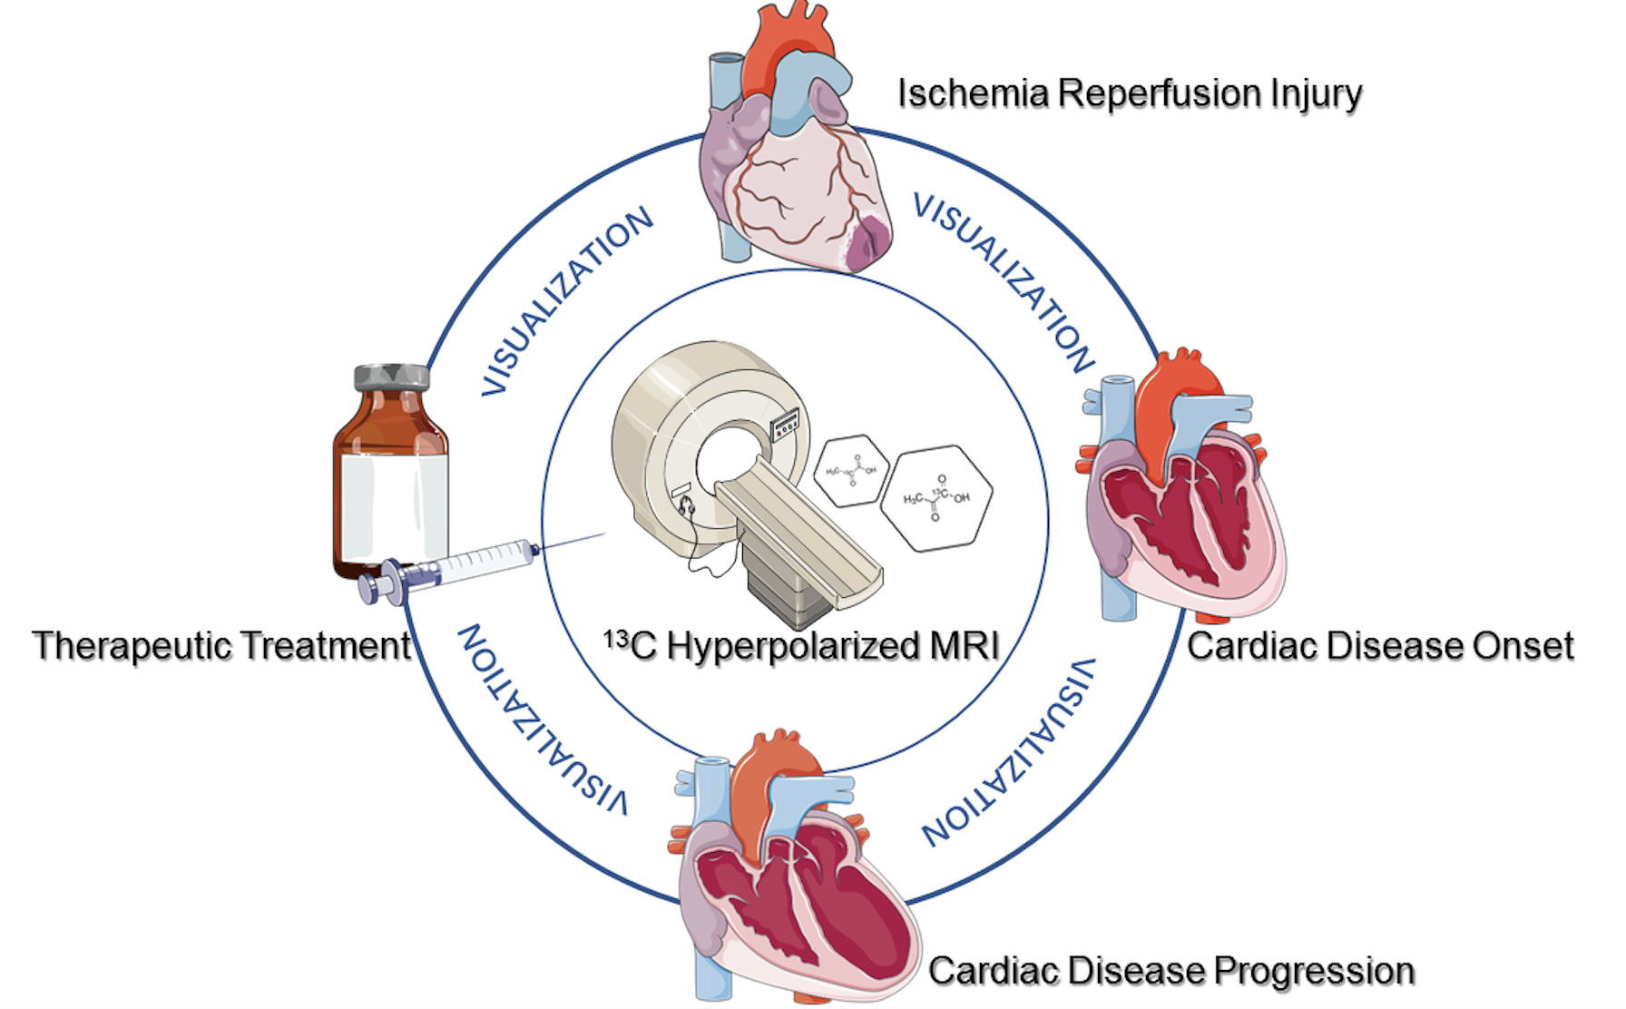
Figure 2. Schematic of the potential clinical application of 13C hyperpolarized magnetic resonance spectroscopy.
Shuo Cong et al, Conditioning Medicine 2021; 4(5):234-243

