Slide 1
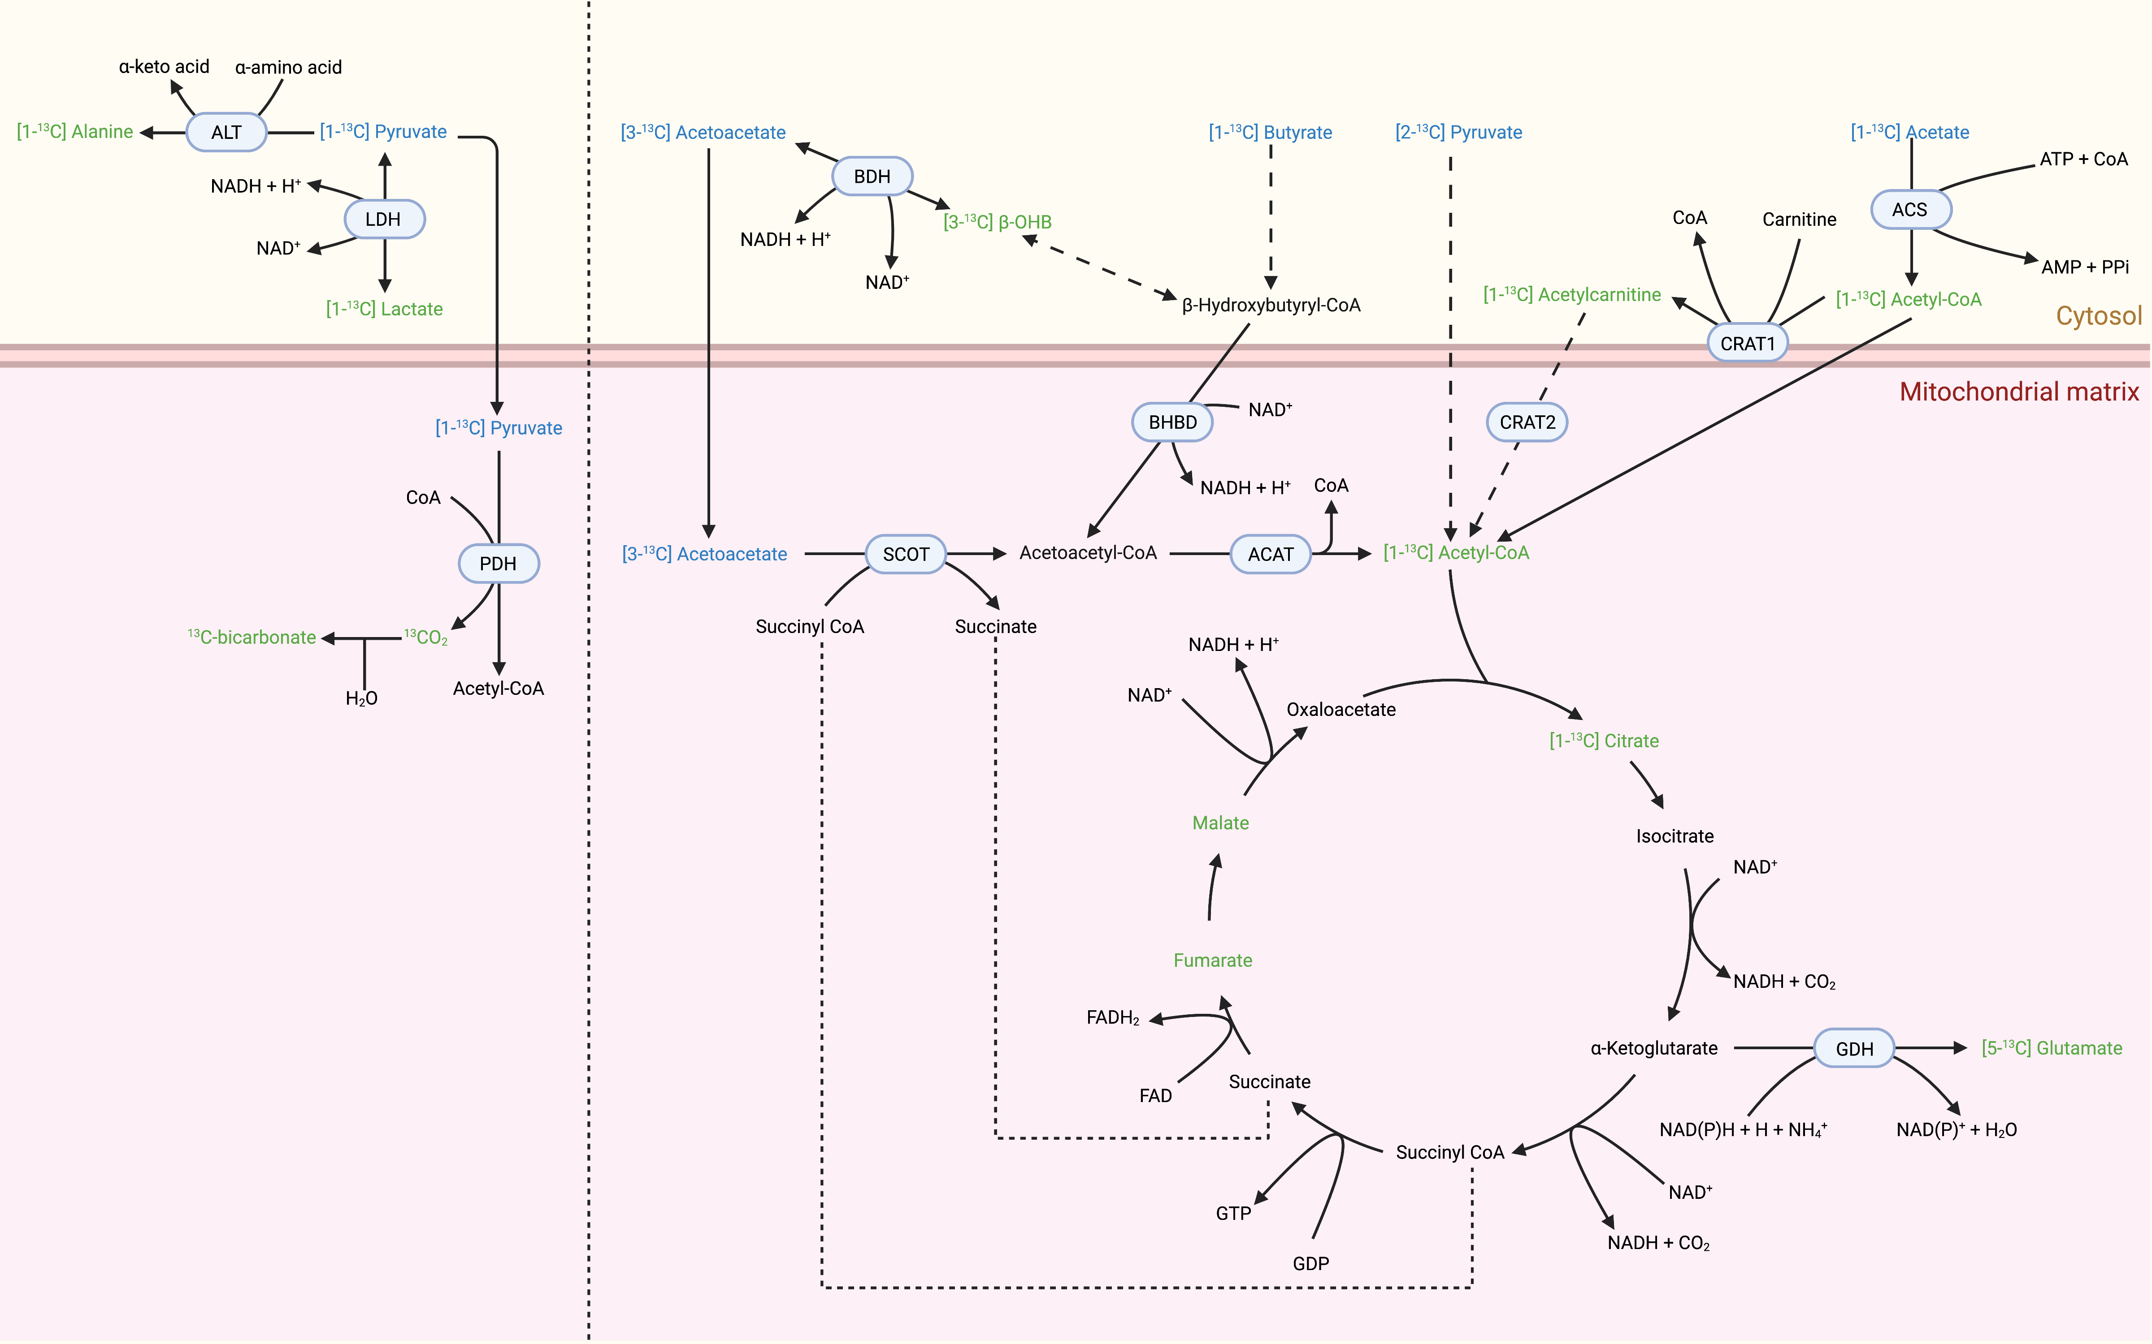
Figure 1. 13C HP MRS probes and downstream metabolites used to track myocardial metabolic changes.
Shuo Cong et al, Conditioning Medicine 2021; 4(5):234-243

