Slide 1
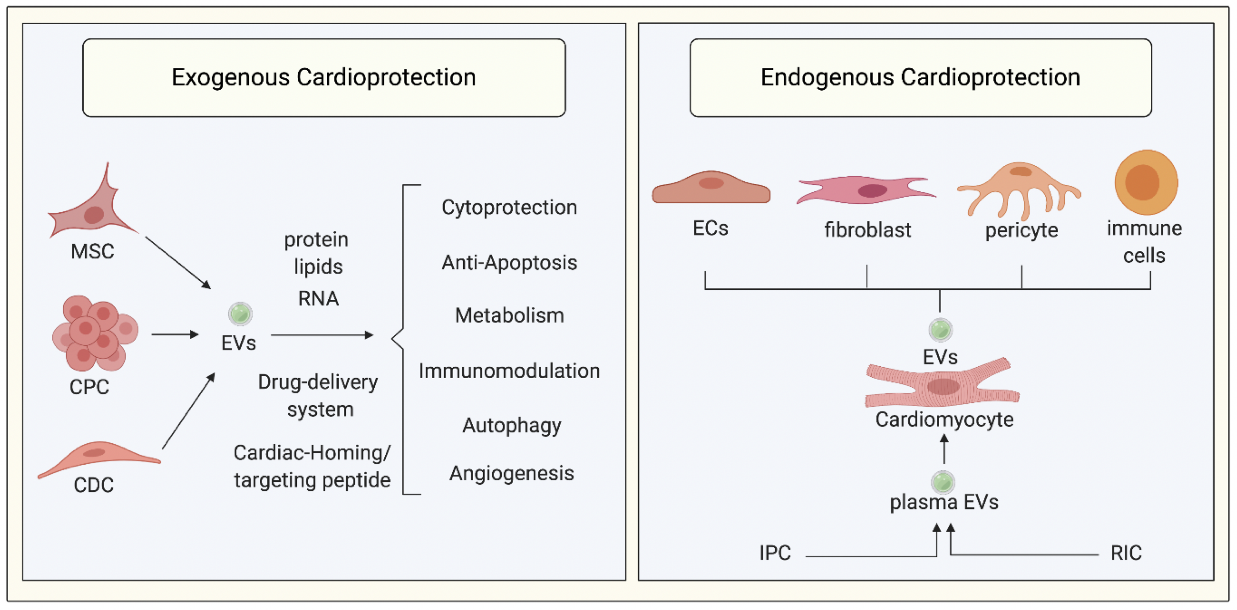
Figure 1. Extracellular vesicles and cardioprotection.
Prakash et al., Conditioning Medicine 2020; 3(4):227-238.

