Slide 1
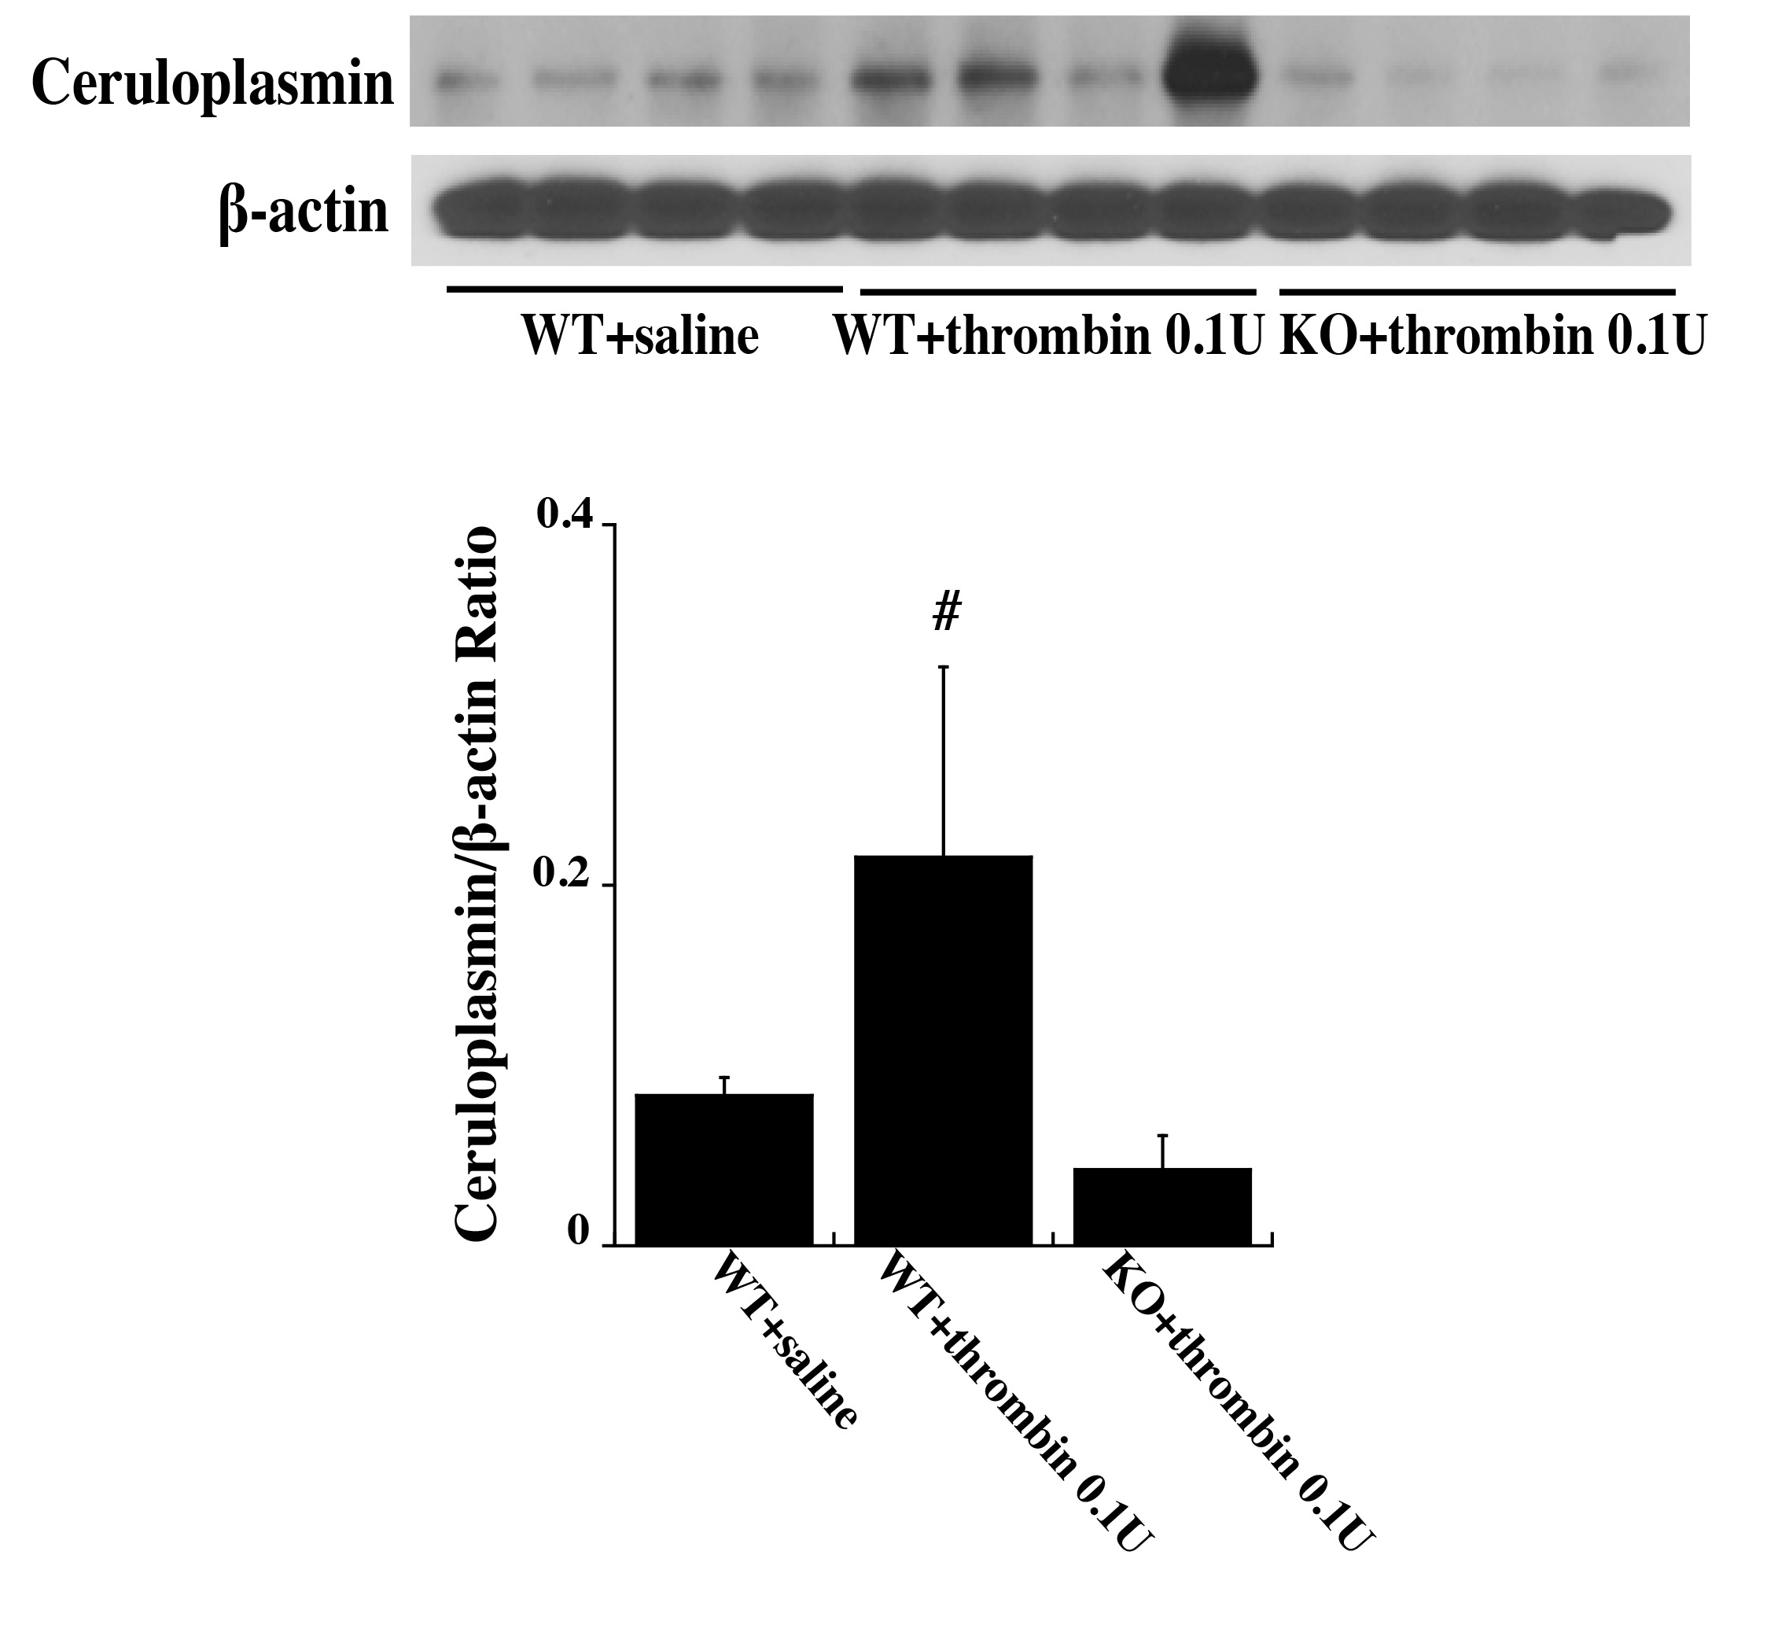
Figure 5. Wild type (WT) and protease activated receptor-1 knockout (KO) mice received an intracerebral injection of 0.1 U thrombin or saline. At 72 h, ceruloplasmin levels in the ipsilateral basal ganglia were assessed by Western blot analysis.
Xuhui Bao et al., Conditioning Medicine 2019; 2(5):185-191.

