Slide 1
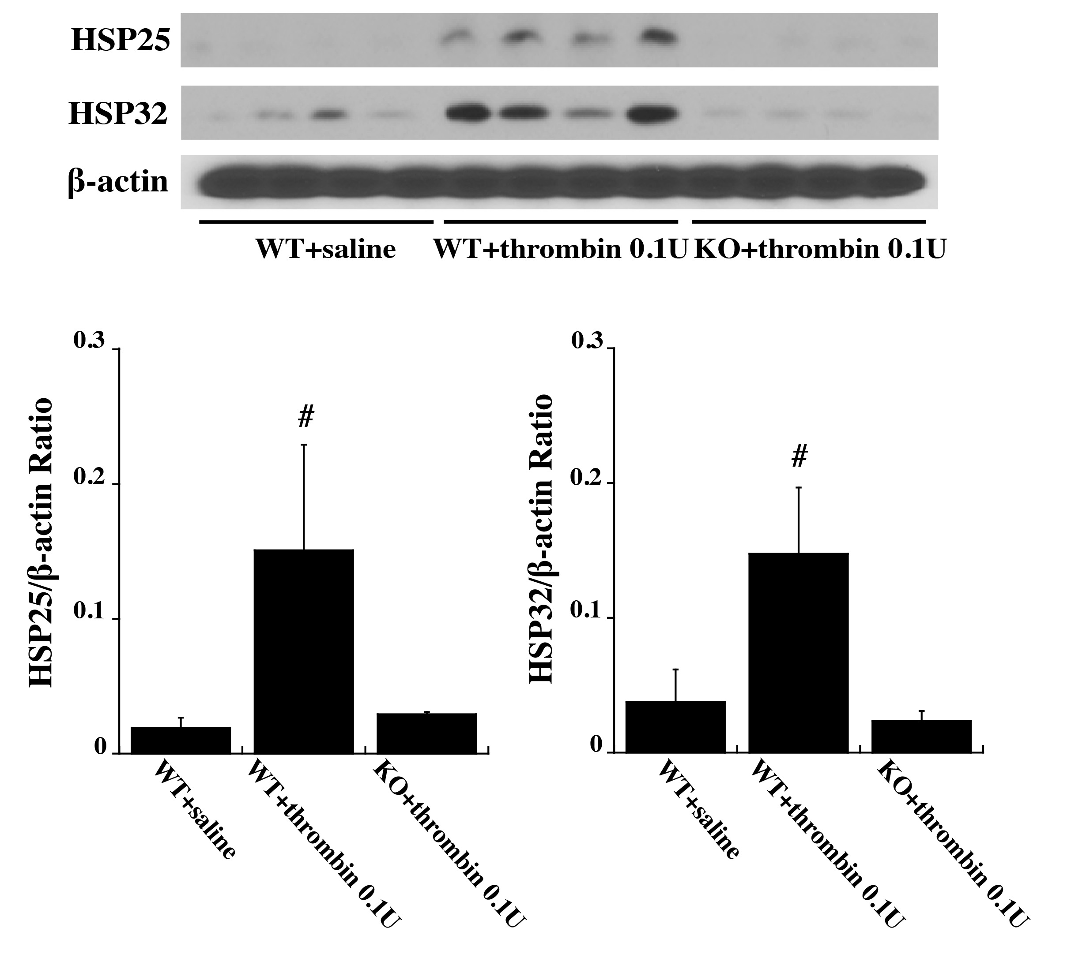
Figure 4. Wild type (WT) and protease activated receptor-1 knockout (KO) mice received an intracerebral injection of 0.1 U thrombin or saline. At 72 h, heat shock protein (HSP) 25 and HSP 32 levels in the ipsilateral basal ganglia were assessed.
Xuhui Bao et al., Conditioning Medicine 2019; 2(5):185-191.

