Slide 1
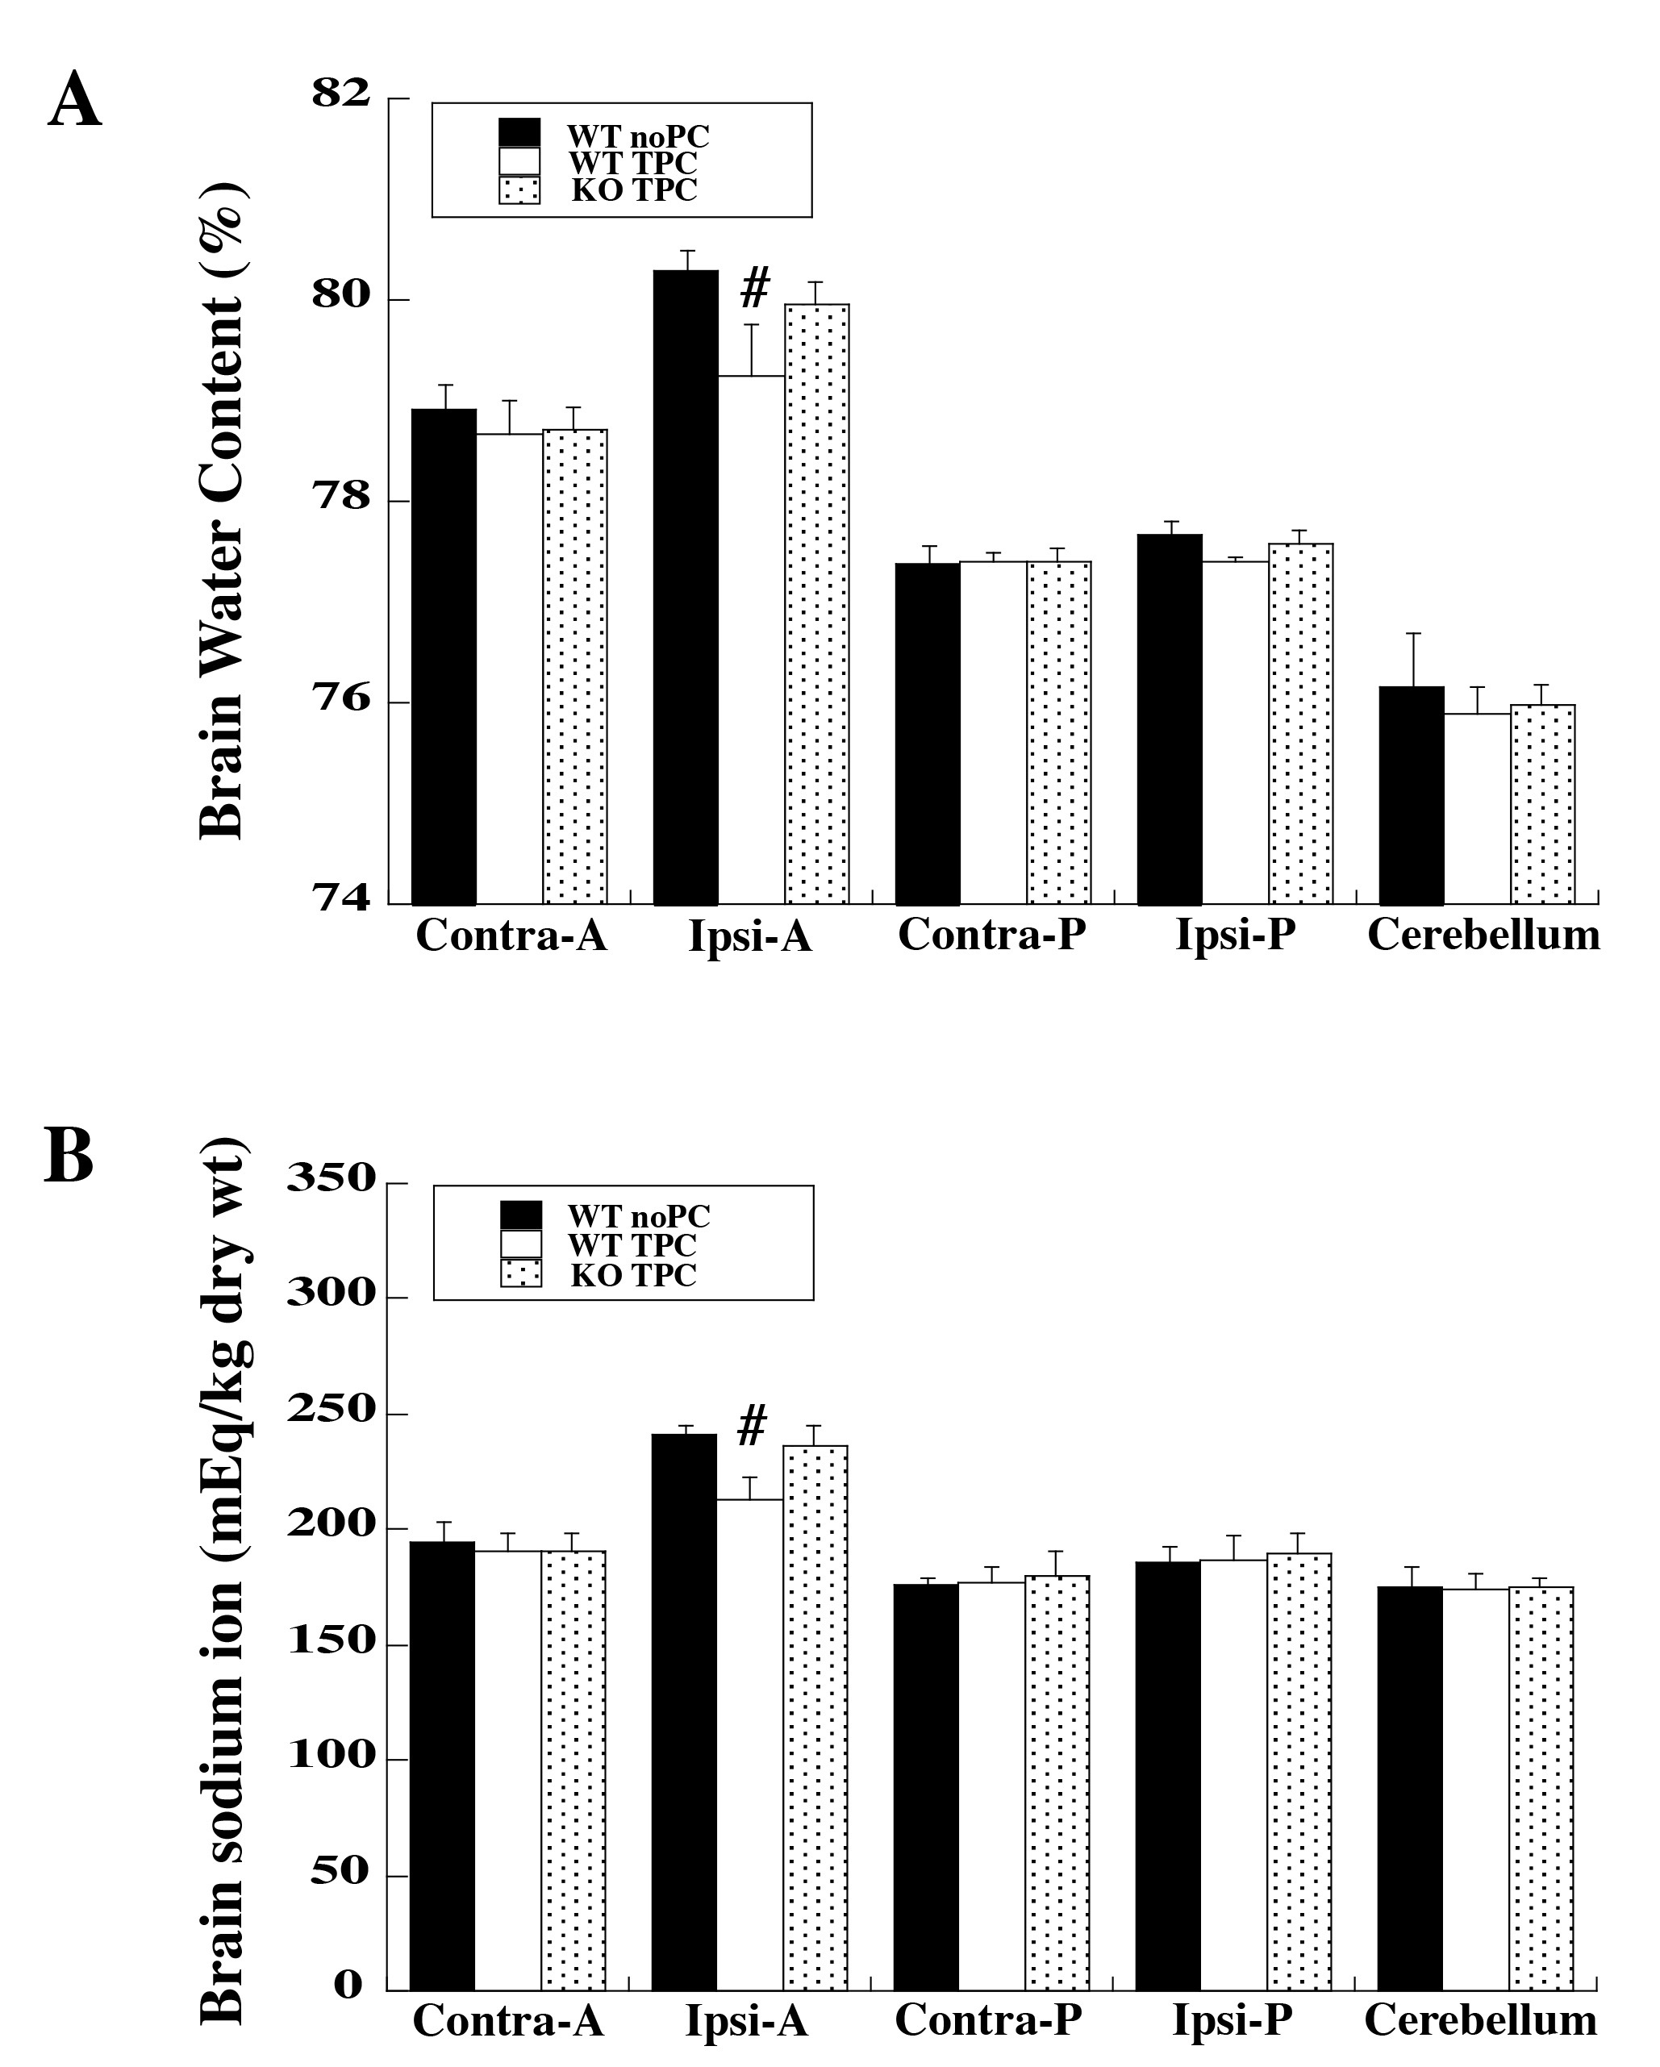
Figure 1. Wild type (WT) and protease activated receptor-1 knockout (KO) mice received intracerebral injections of 0.1 U thrombin (thrombin preconditioning, TPC) or saline (no PC) followed by a large dose of thrombin (0.5 U) at 72 hours. Twenty-four hours after intracerebral injection of 0.5 U thrombin, (A) brain water and (B) sodium ion contents were determined.
Xuhui Bao et al., Conditioning Medicine 2019; 2(5):185-191.

