Slide 1
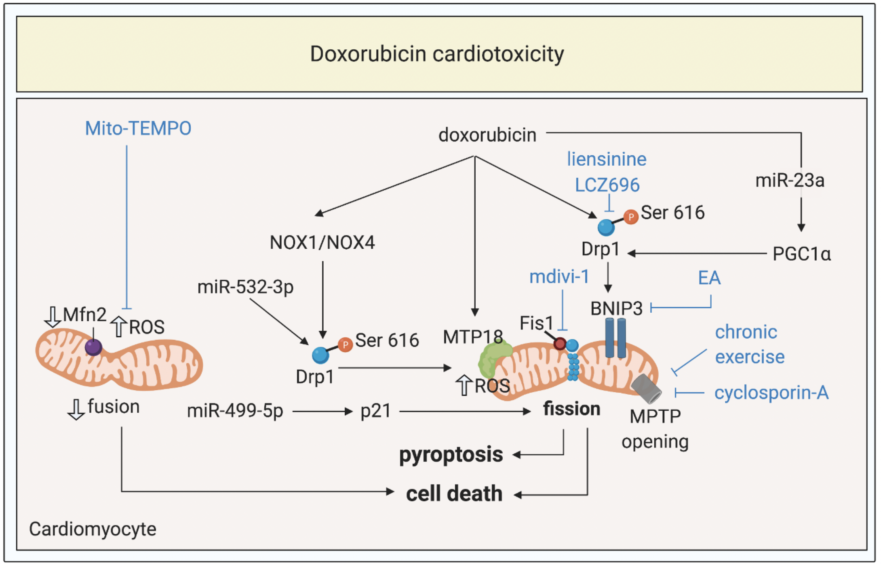
Figure 3. Targeting mitochondrial shaping proteins as treatment strategy for doxorubicin cardiotoxicity.
Kalkhoran et al., Conditioning Medicine 2020; 3(4):216-226.

