Slide 1
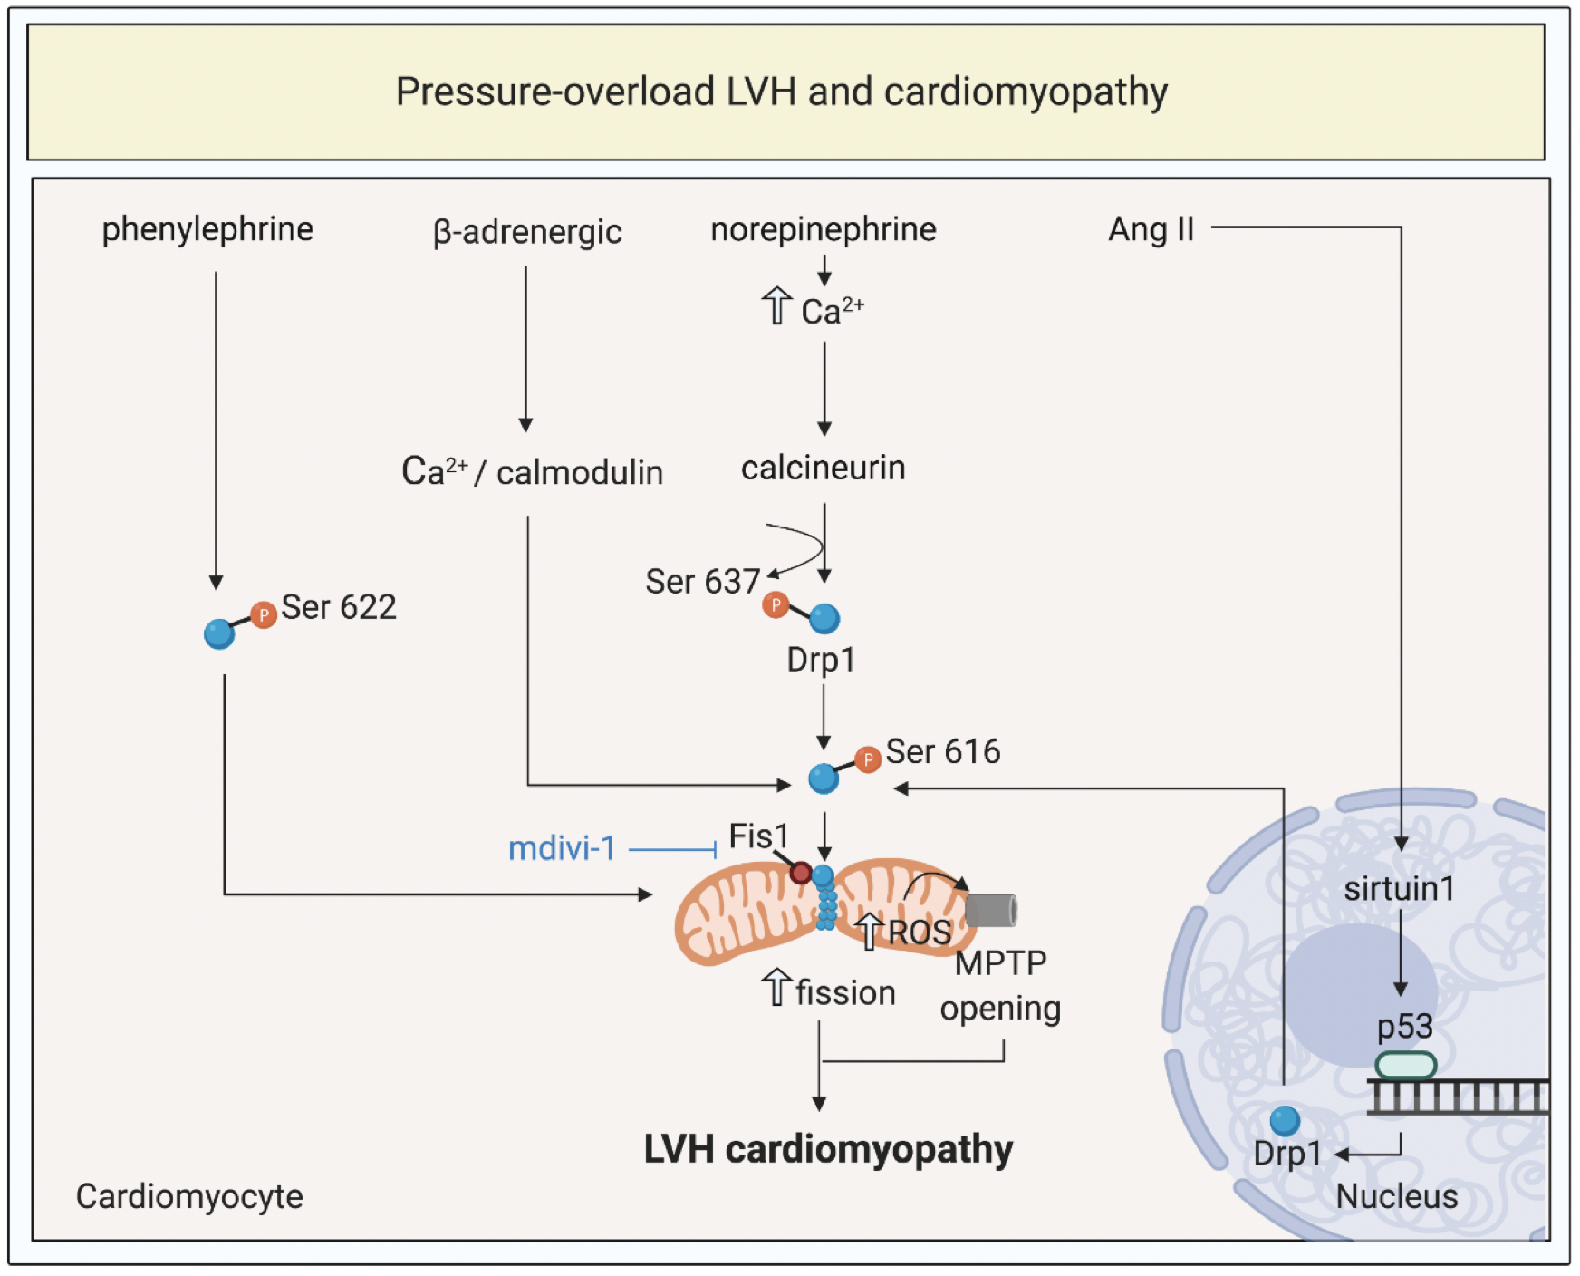
Figure 2. Targeting mitochondrial shaping proteins as a treatment strategy for pressure-overload left ventricular hypertrophy (LVH) and cardiomyopathy.
Kalkhoran et al., Conditioning Medicine 2020; 3(4):216-226.

