Slide 1
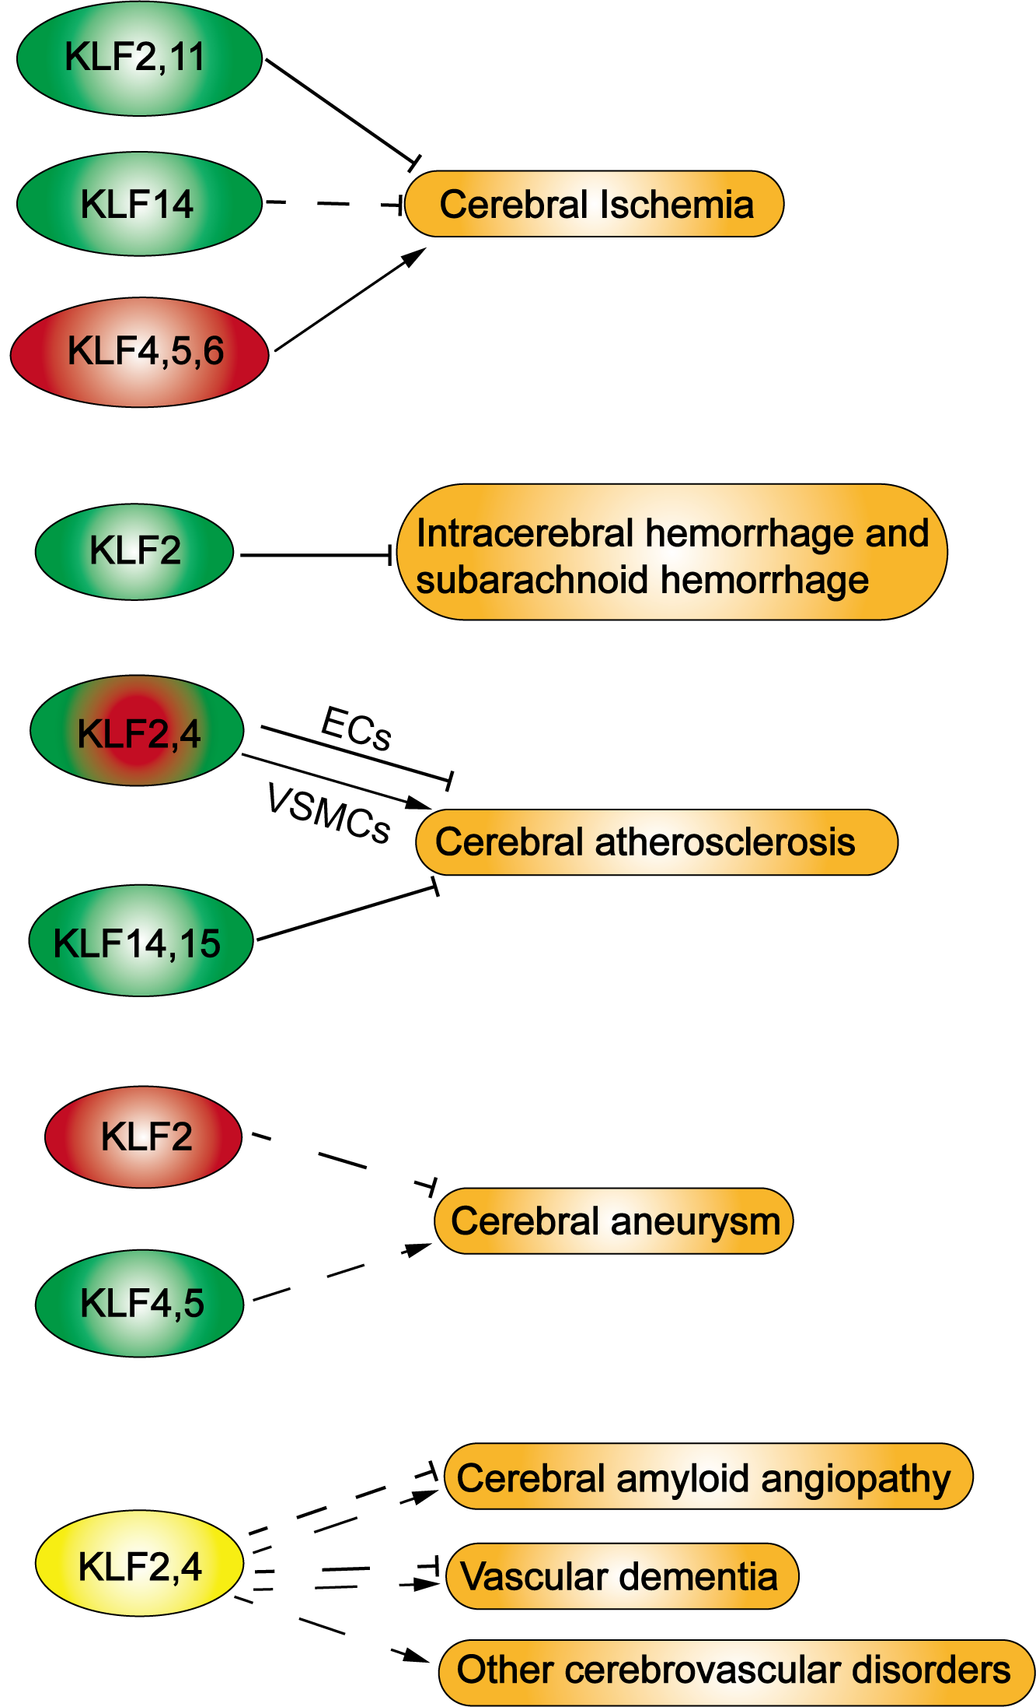
Figure 2. Schematic representation of distinct roles of KLF transcription factors in the pathogenesis of various cerebrovascular diseases.
Jing Zhang et al., Conditioning Medicine 2019; 2(5):192-203.

