Slide 1
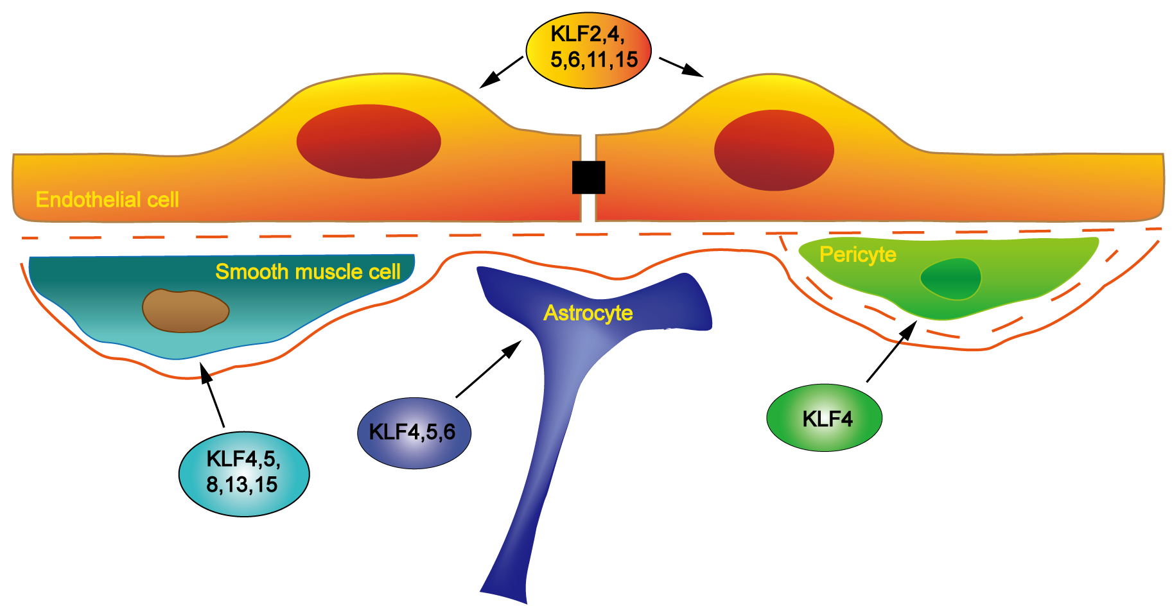
Figure 1. Schematic representation of the expression of KLF family members in different vascular cells.
Jing Zhang et al., Conditioning Medicine 2019; 2(5):192-203.

