Slide 1
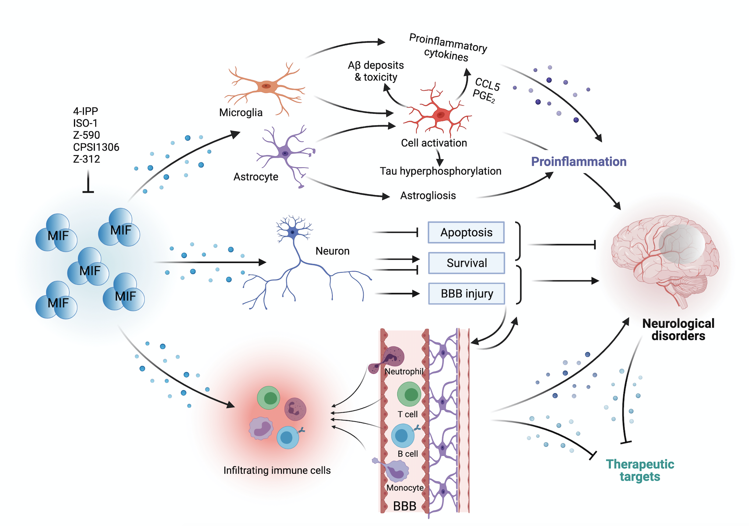
Figure 1. MIF has been implicated in neuroinflammation through the regulation of microglia, astrocytes, neurons, and infiltrating immune cells.
Zan et al, Conditioning Medicine 2021; 4(5):216-233

