Slide 1
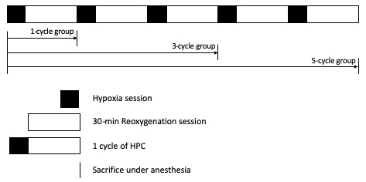
Figure 1. Hypoxic preconditioning (HPC) protocol. Filled and blank rectangular boxes refer to hypoxia sessions and 30-min reoxygenation sessions respectively, which together comprise a 1-cycle HPC. Mice were sacrificed at the end of the reoxygenation session in each group.
Liu et al., Conditioning Medicine 2019; 2(6):280-283.

