Slide 1
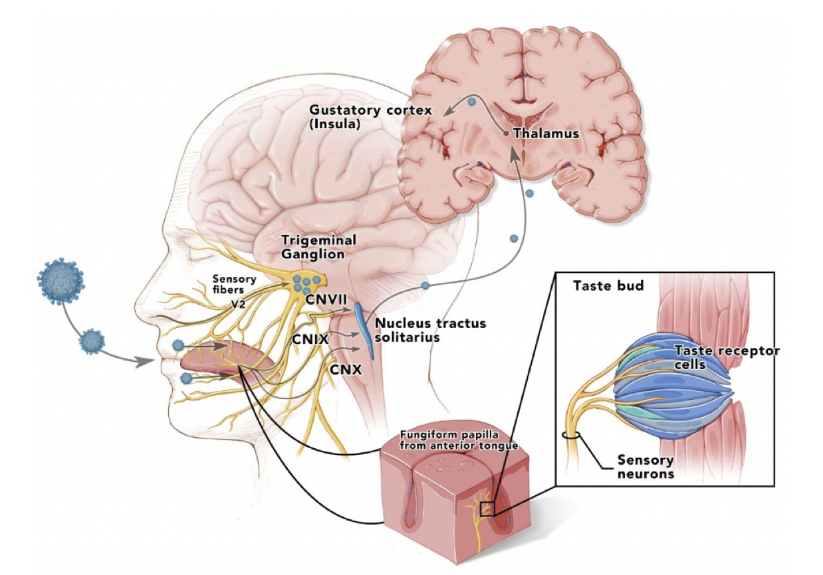
Figure 2. Taste pathways showing infection of lingual fungiform, vallate papillae, and viral spread up the facial (chorda tympani), glossopharyngeal, and vagus nerves to ipsilateral nucleus solitarius in medulla, and then up to thalamus and cortex.
Hess et al., Conditioning Medicine 2020; 3(5):241-245.

