Slide 1
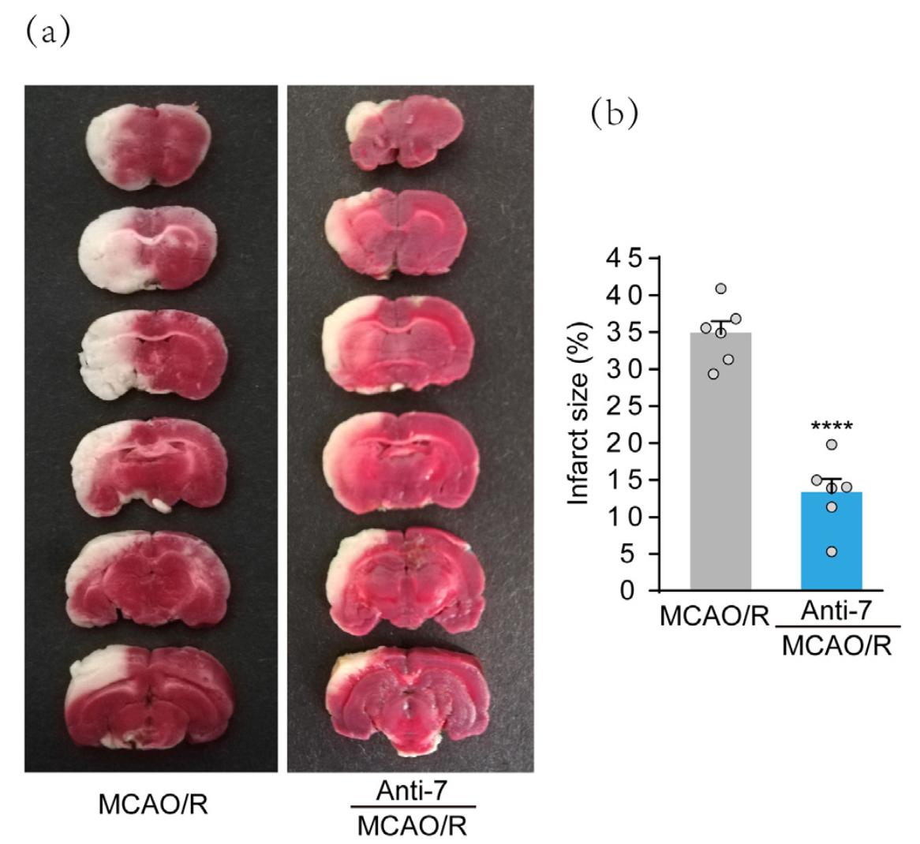
Figure 2.
Shi et al., Conditioning Medicine 2022; 5(5): 186-191.

