Slide 1
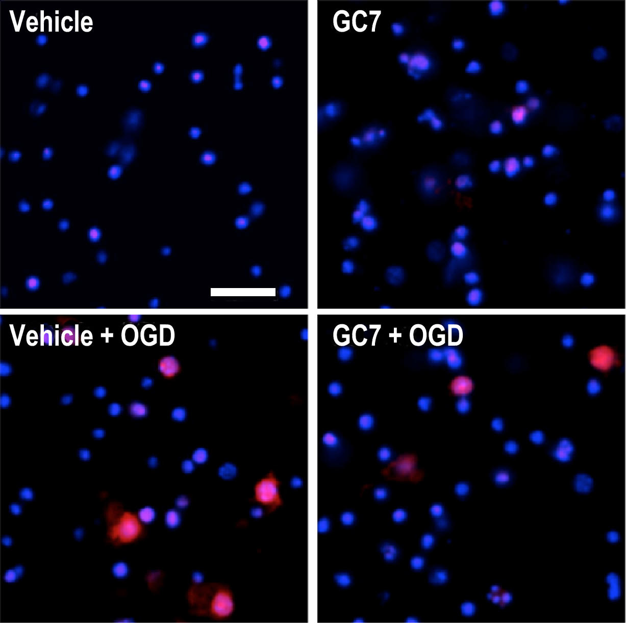
Figure 3. Anti-ischemic effect of GC7 in an in vitro oxygen-glucose deprivation (OGD) model of stroke in neurons.
Nicolas Blondeau and Michel Tauc, Conditioning Medicine 2021; 4(4):192-197.

