Slide 1
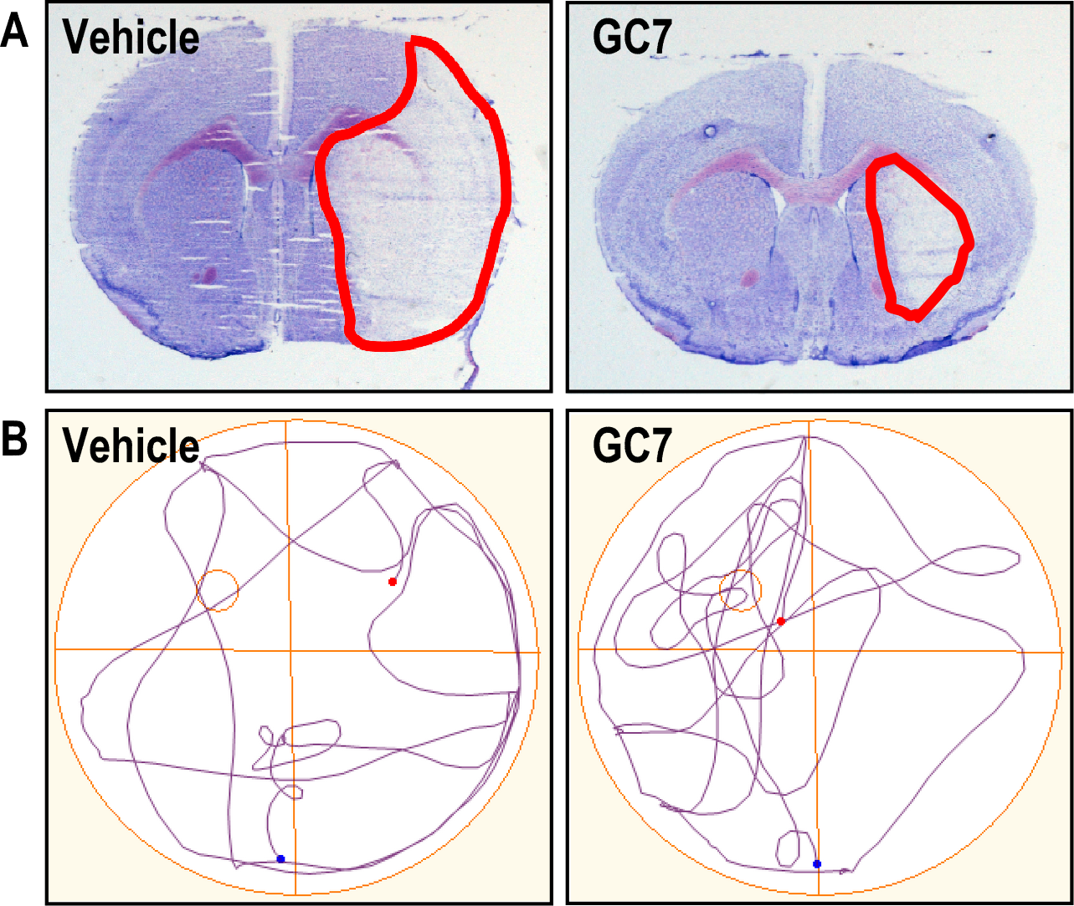
Figure 2. Inhibition of deoxyhypusine synthase by GC7 reduces brain injury and improves spontaneous functional recovery after ischemic stroke.
Nicolas Blondeau and Michel Tauc, Conditioning Medicine 2021; 4(4):192-197.

