Slide 1
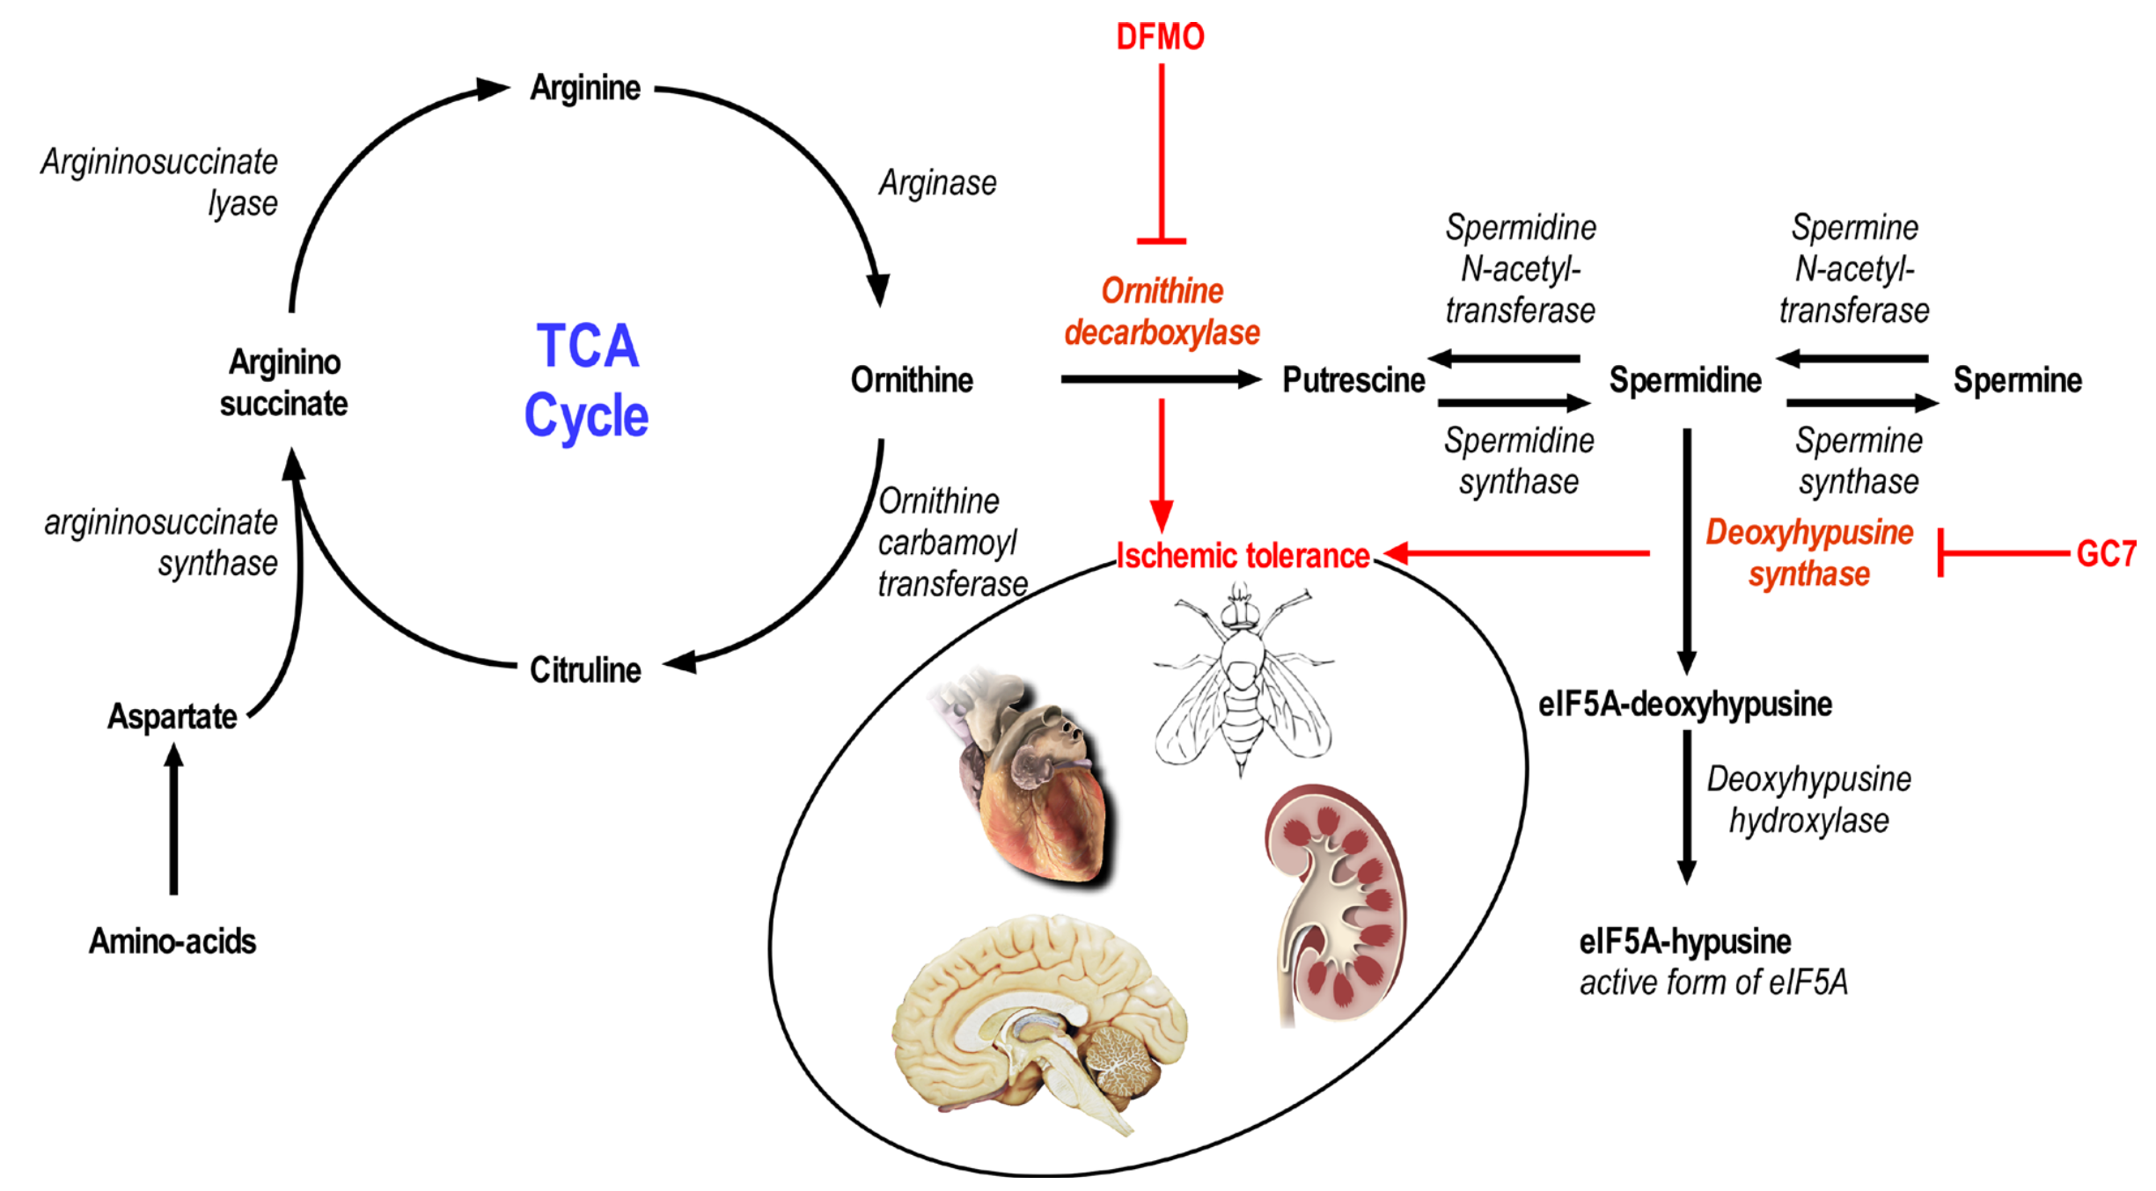
Figure 1. Schema of the urea cycle involved in amino acid catabolism and leading to the synthesis of polyamines by sequential enzymatic catalysis and the activation by hypusination of the translation initiation factor eI5A (modified from Tauc et al., 2019)
Nicolas Blondeau and Michel Tauc, Conditioning Medicine 2021; 4(4):192-197.

