Slide 1
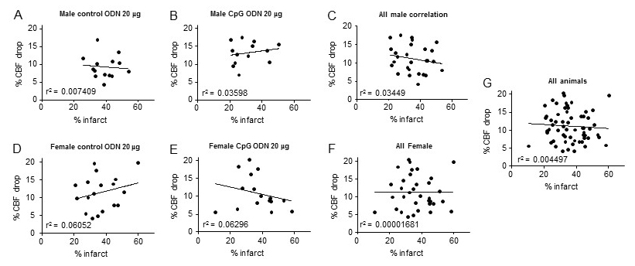
Figure 5. Graphs showing correlation between infarct volume and drop in CBF during MCAO in different experimental groups.
Kunjan R. Dave et al., Conditioning Medicine 2019; 2(4):178-184.

