Slide 1
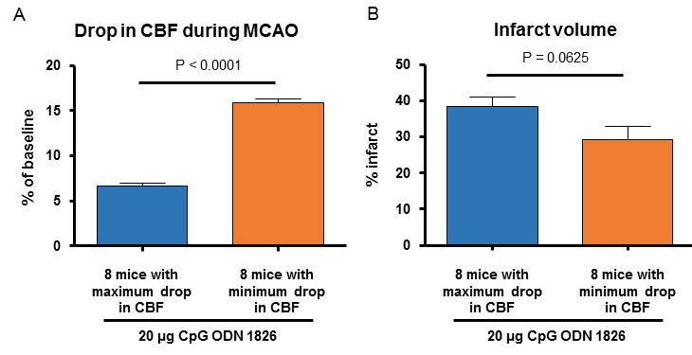
Figure 3. Infarct volume and (B) drop in CBF during MCAO in 8 mice belonging to the drug-treated group where we observed a maximum drop in CBF and 8 mice belonging to the drug-treated group where we observed a minimum drop in CBF.
Kunjan R. Dave et al., Conditioning Medicine 2019; 2(4):178-184.

