Slide 1
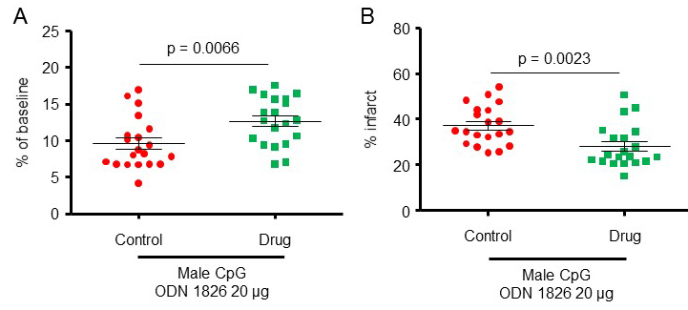
Figure 2. The protective effect of CpG-ODN1826 preconditioning in a larger number of young male mice.
Kunjan R. Dave et al., Conditioning Medicine 2019; 2(4):178-184.

