Slide 1
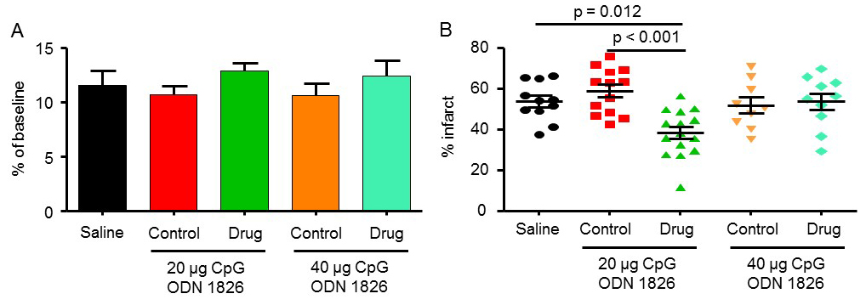
Figure 1. The effect of CpG ODN 1826 preconditioning on (A) CBF drop during ischemia and (B) infarct size in a mouse model of focal ischemia.
Kunjan R. Dave et al., Conditioning Medicine 2019; 2(4):178-184.

