Slide 1
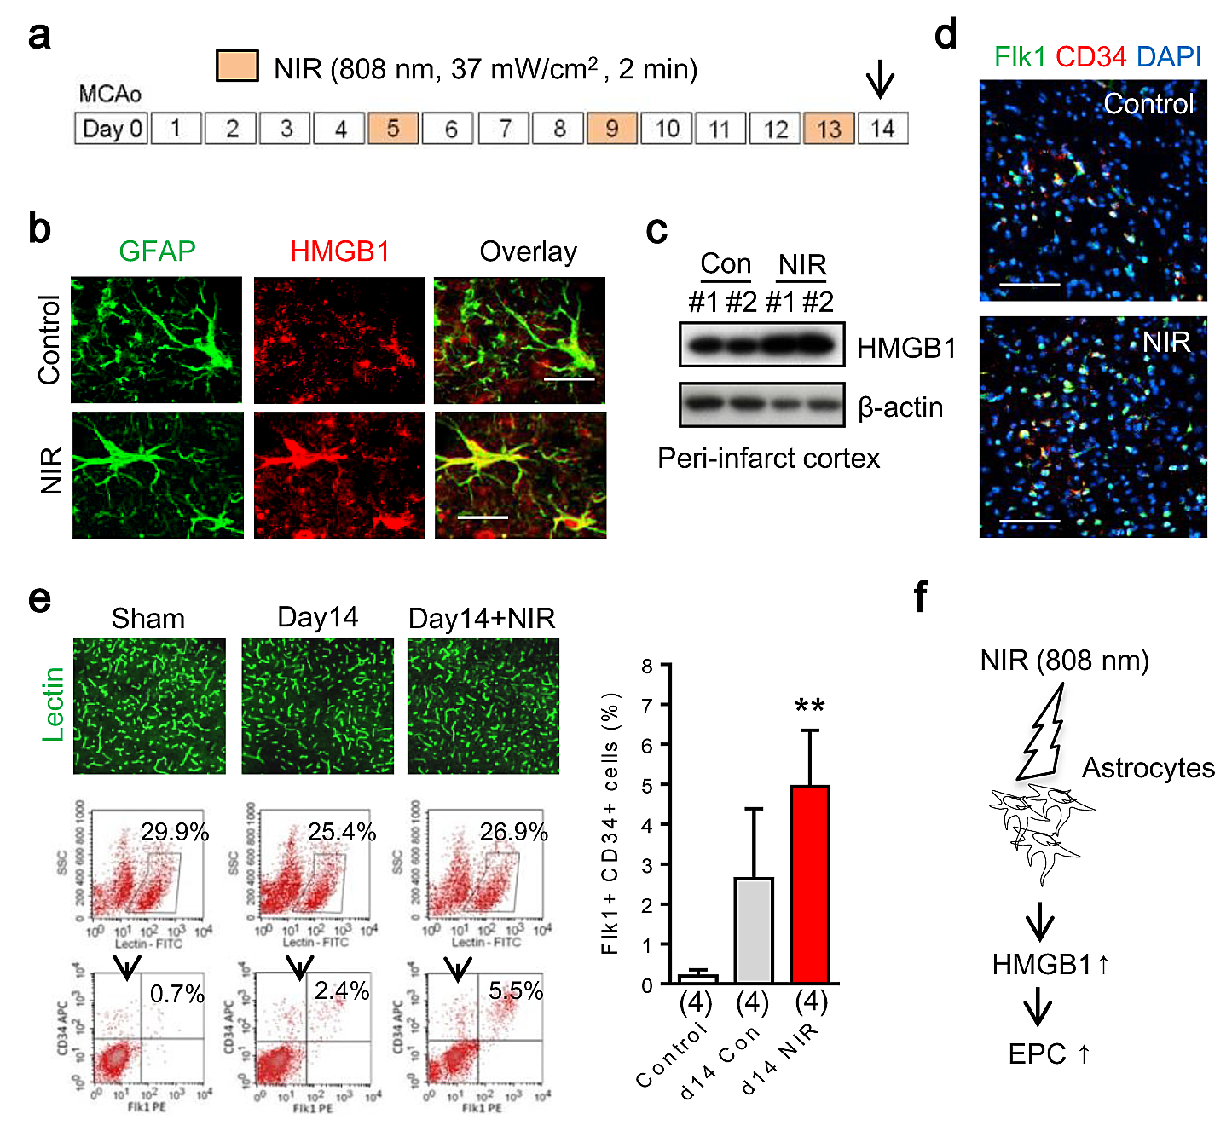
Figure 4. In vivo transcranial near infrared light increases EPC accumulation after focal cerebral ischemia in C57bl6 mice.
Andrew Vahabzadeh-Hagh et al., Conditioning Medicine 2019; 2(4):170-177.

