Slide 1
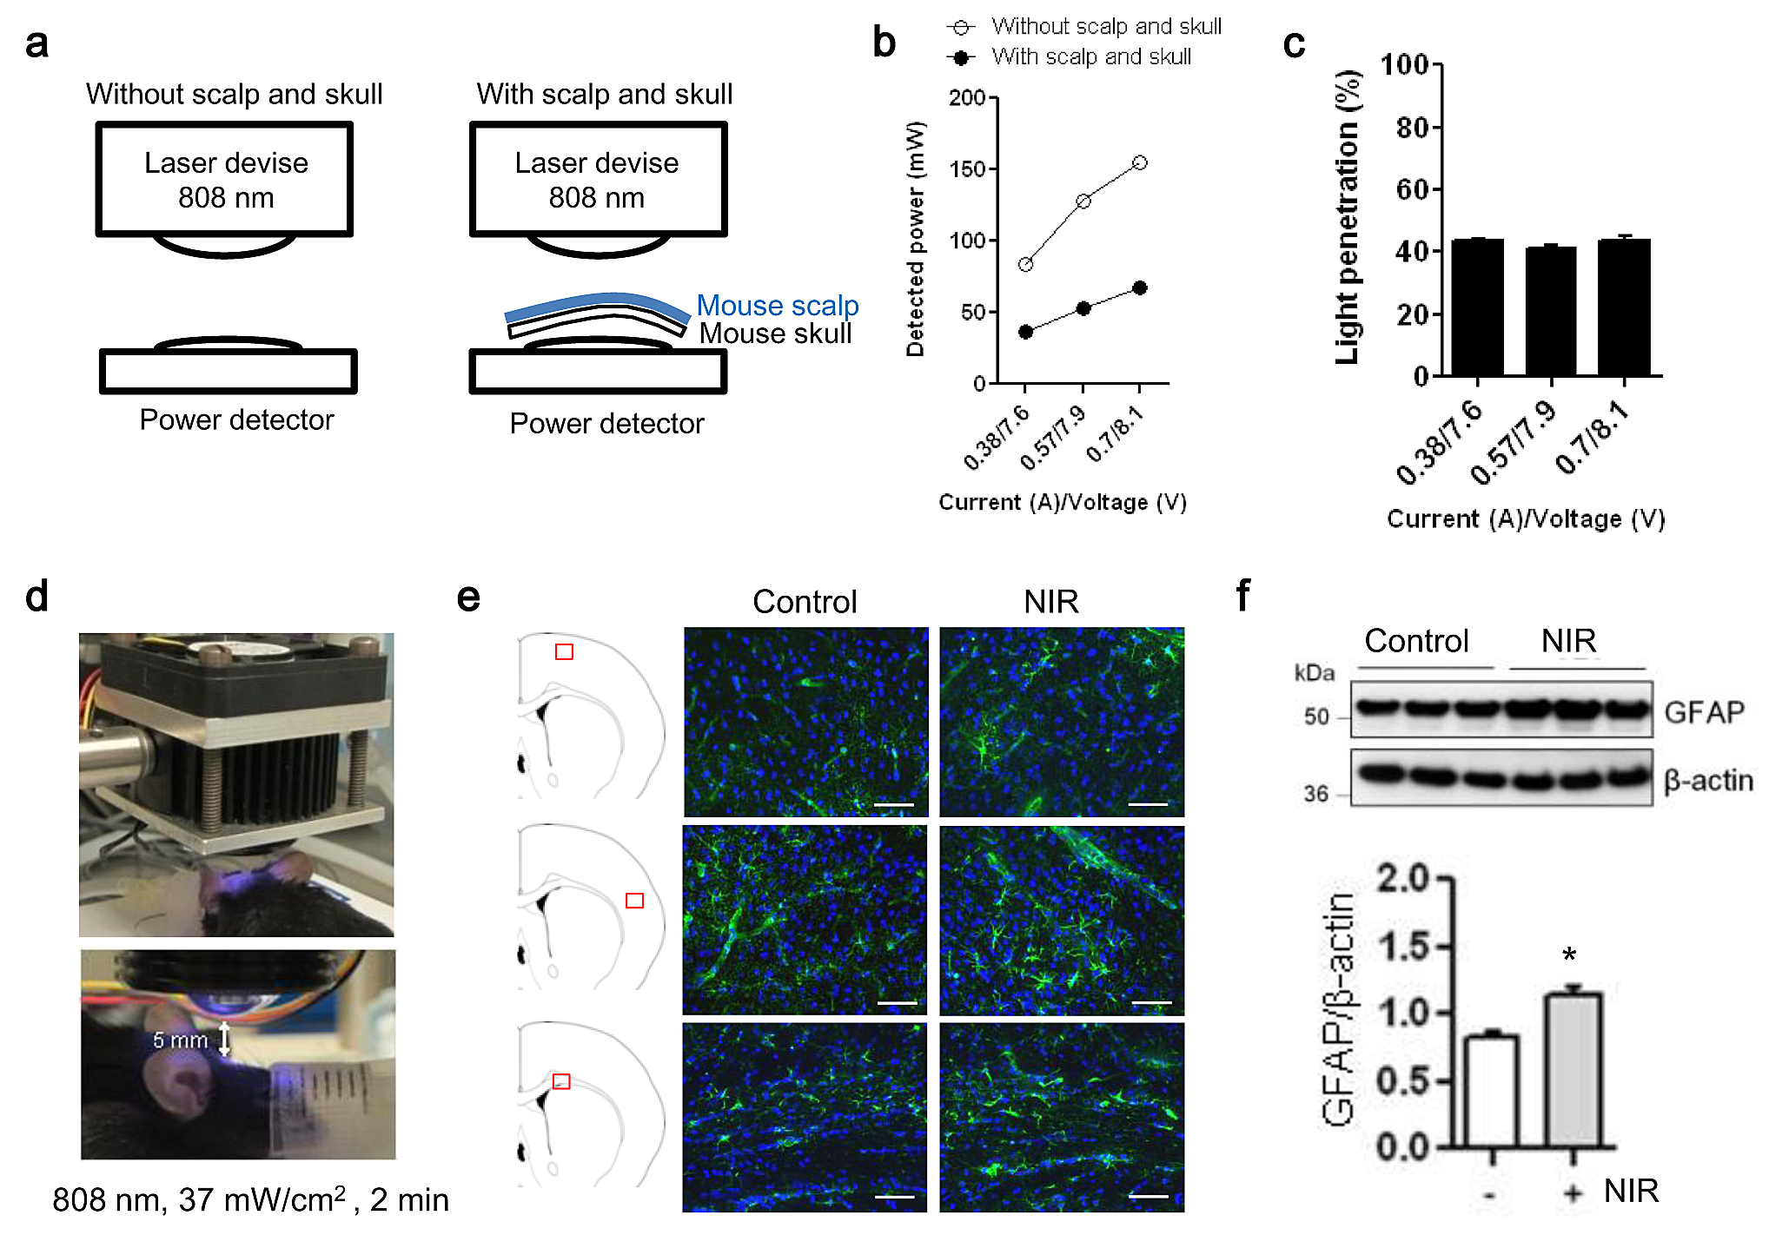
Figure 3. In vivo transcranial NIR-light increases GFAP expression in the brains of treated C57BL/6 mice.
Andrew Vahabzadeh-Hagh et al., Conditioning Medicine 2019; 2(4):170-177.

