Slide 1
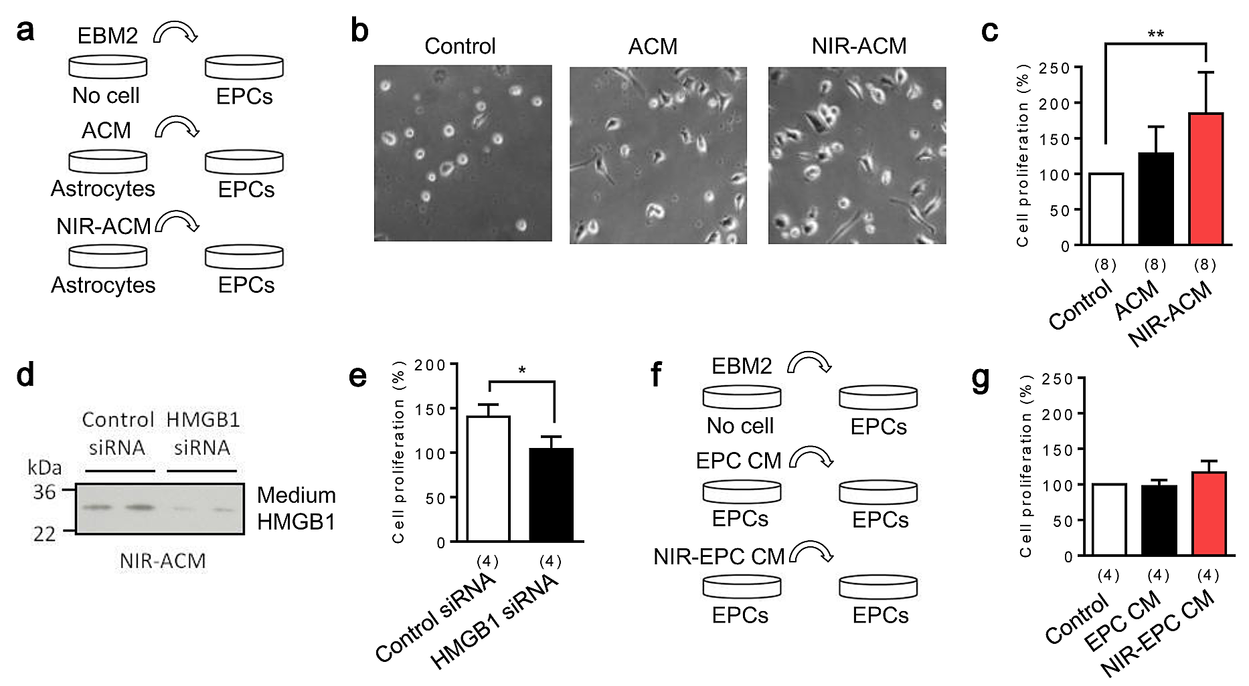
Figure 2. Astrocytic HMGB1 increases endothelial progenitor cells (EPC) proliferation in vitro.
Andrew Vahabzadeh-Hagh et al., Conditioning Medicine 2019; 2(4):170-177.

