Slide 1
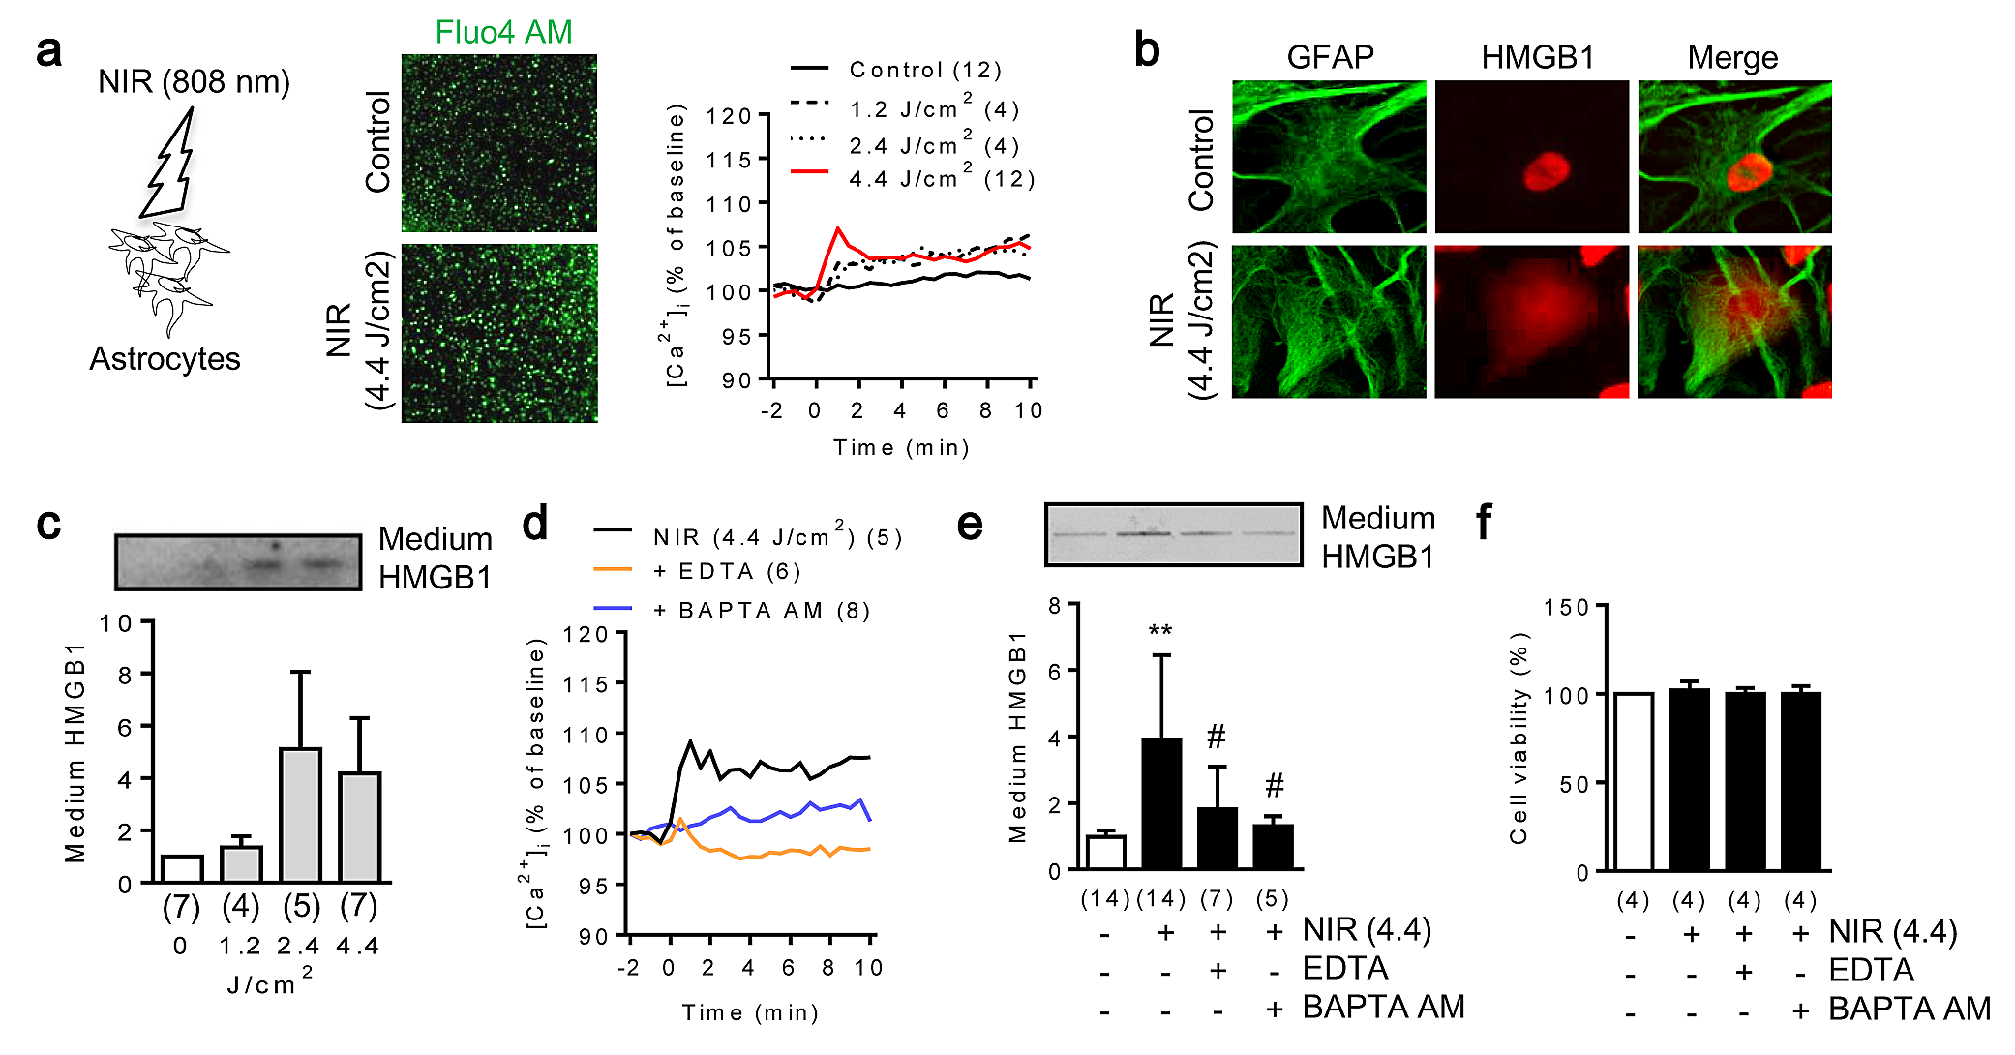
Figure 1. Near infrared light (NIR) promotes HMGB1 secretion via an increase of intracellular calcium in rat cortical astrocytes.
Andrew Vahabzadeh-Hagh et al., Conditioning Medicine 2019; 2(4):170-177.

