Slide 1
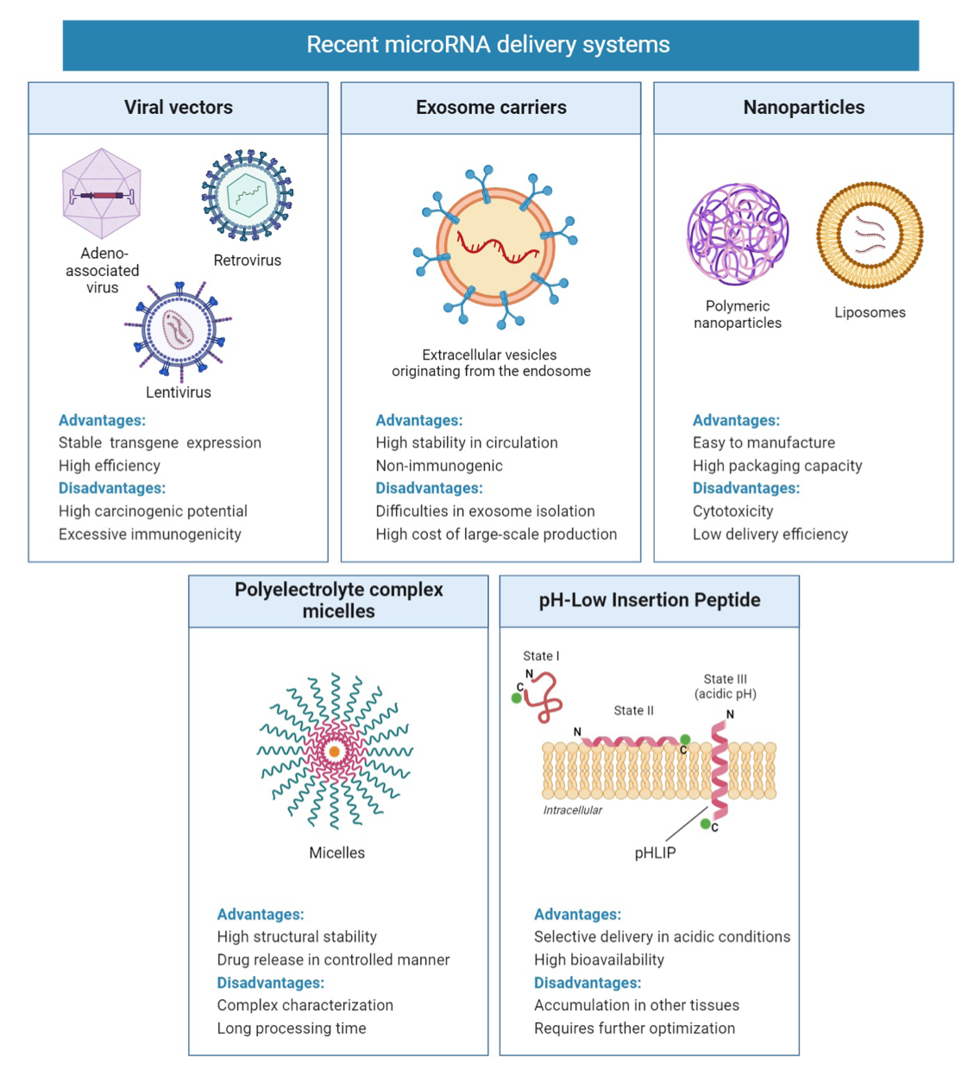
Figure 1.
Griñán and Rotllan Conditioning Medicine 2022; 5(5): 165-171.

