Slide 1
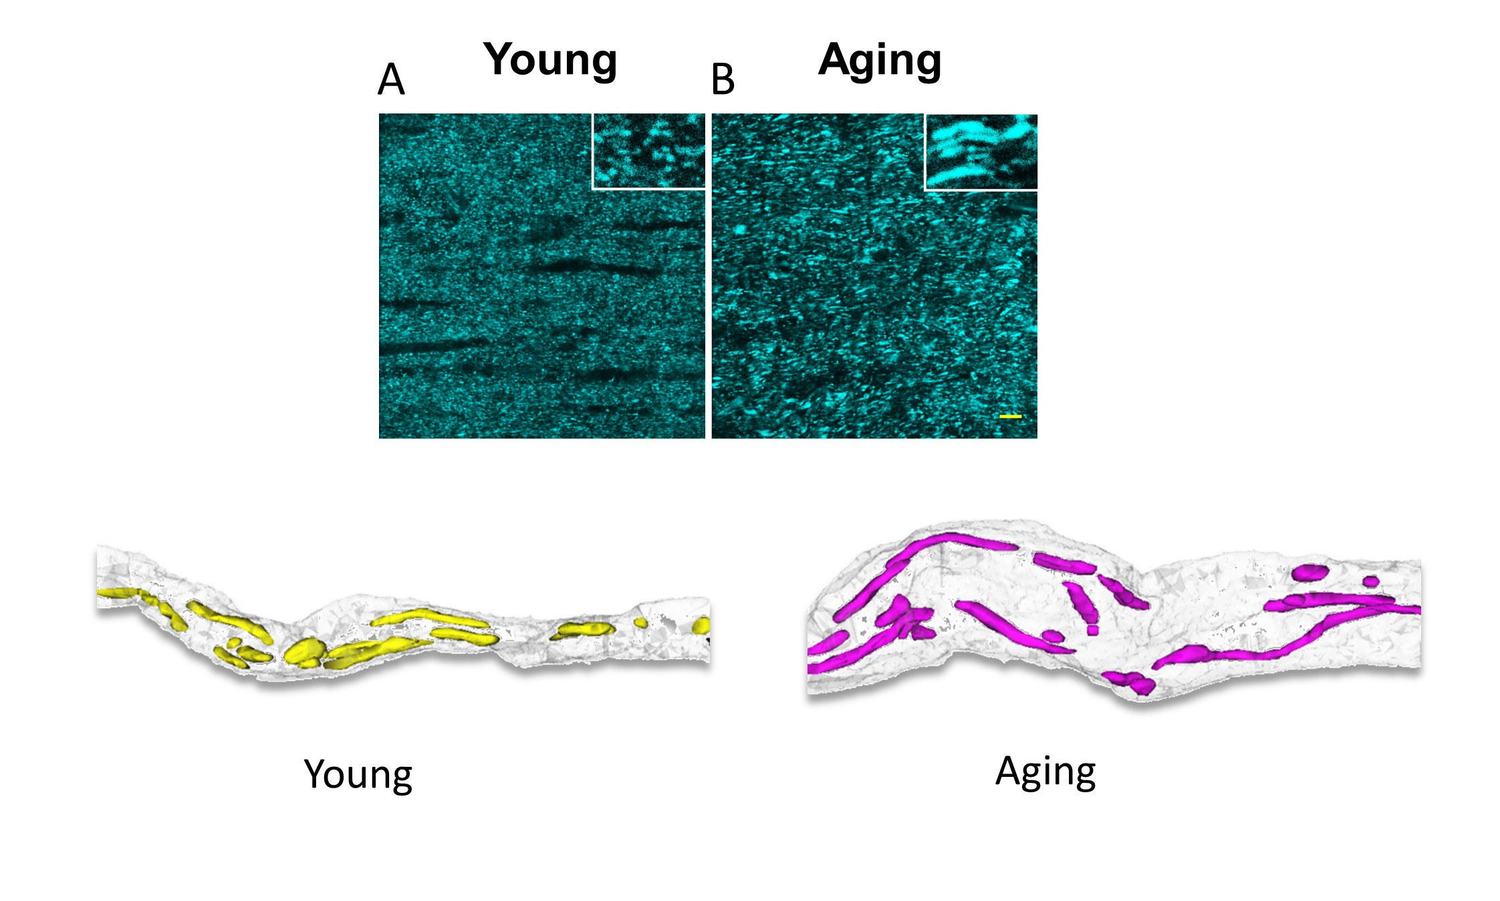
Figure 3. Aging increases the length and thickness of mitochondria as seen in CFP (+) mitochondria in optic nerves obtained from Thy-1 mito-CFP mice (upper two panels).
Zerimech et al., Conditioning Medicine 2021; 4(3):151-160.

