Slide 1
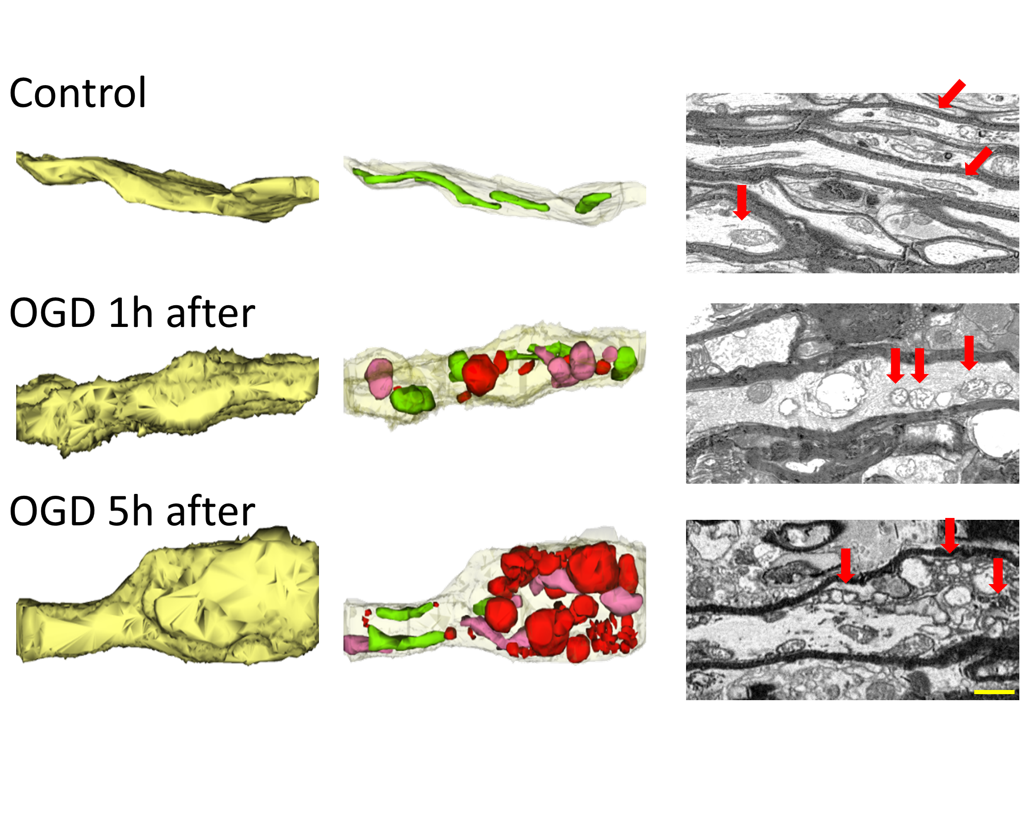
Figure 2. Three-dimensional construction of control axons (yellow, left top) with their elongated green mitochondria (middle top) and the two- dimensional electron micrographs of myelinated axons with numerous elongated mitochondria with their cristea (red arrows).
Zerimech et al., Conditioning Medicine 2021; 4(3):151-160.

