Slide 1
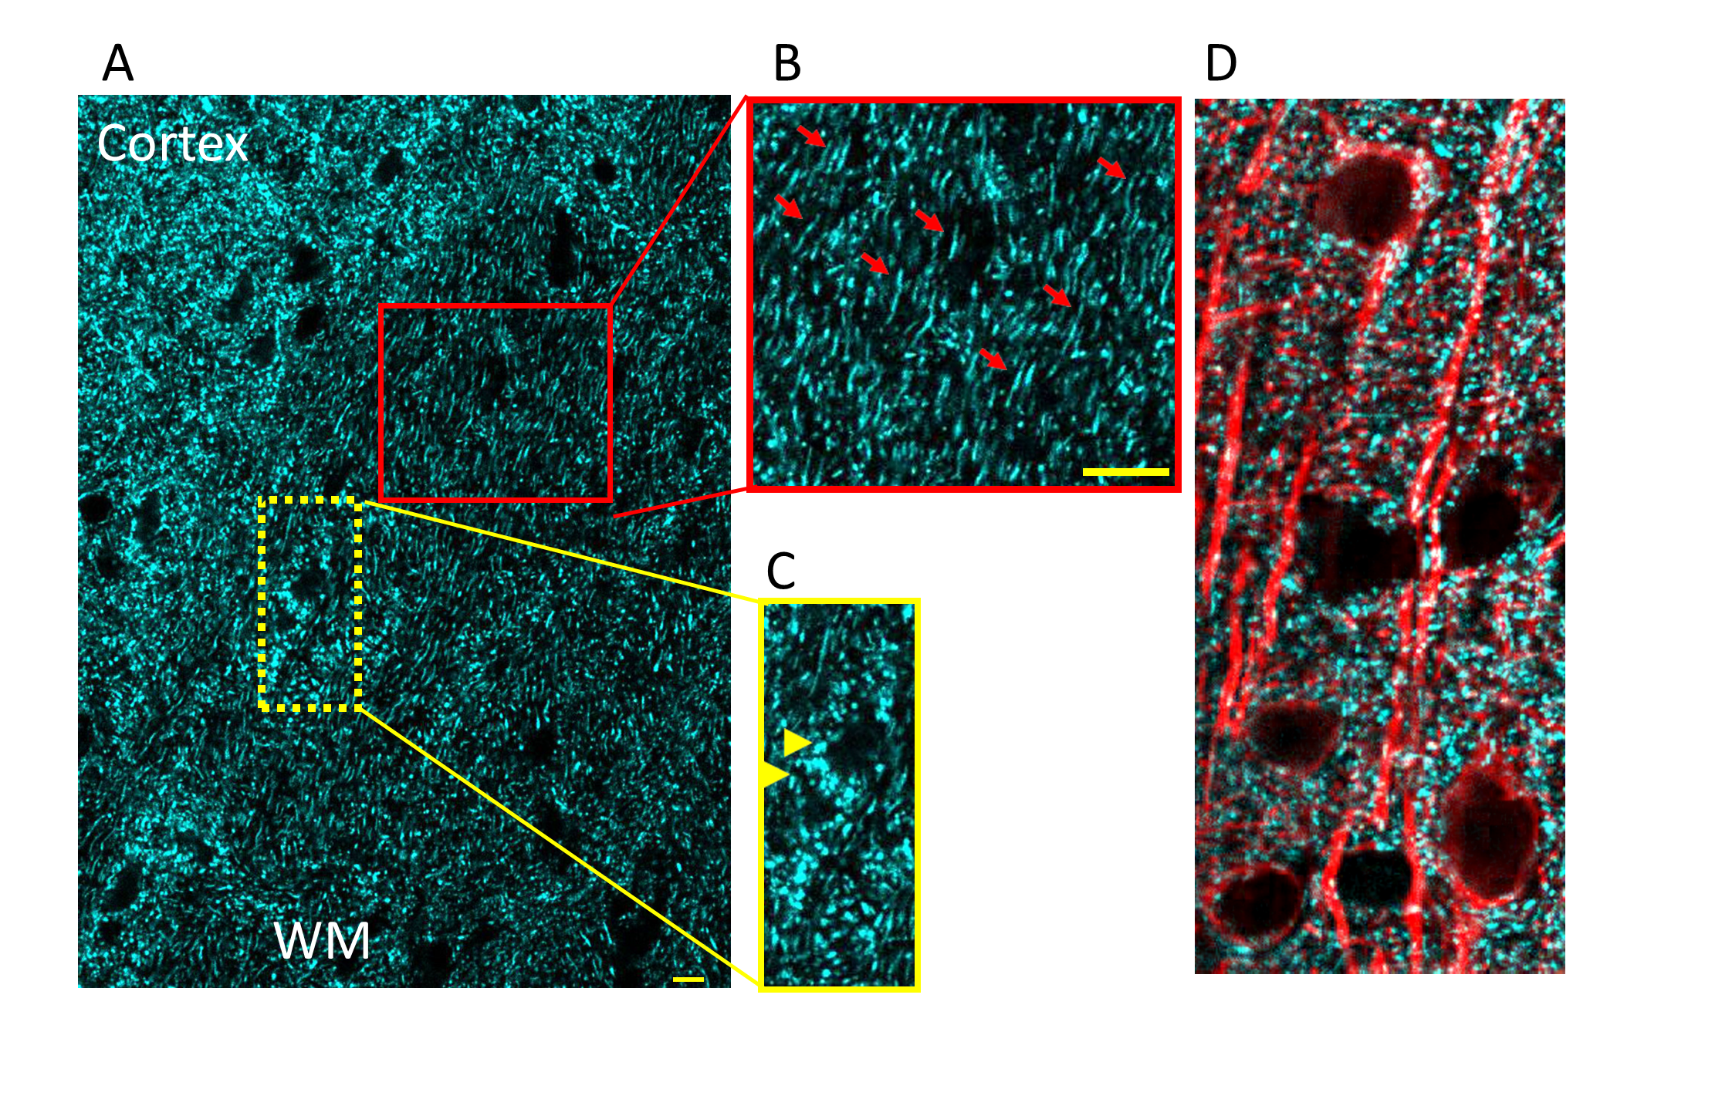
Figure 1. (A, C) Mitochondria in neuronal cell bodies (yellow arrow heads) and (B) nerve processes (red arrows); bar = 10 μm. (D) Combining cyan fluorescent protein (CFP) with microtubule associated protein 2 creates useful images in which to contrast mitochondrial morphology in the perinuclear region of cell bodies as compared with neuronal processes. A "preconditioned mitochondria" is expected to conform to the size and shape of its cellular location.
Zerimech et al., Conditioning Medicine 2021; 4(3):151-160.

