Slide 1
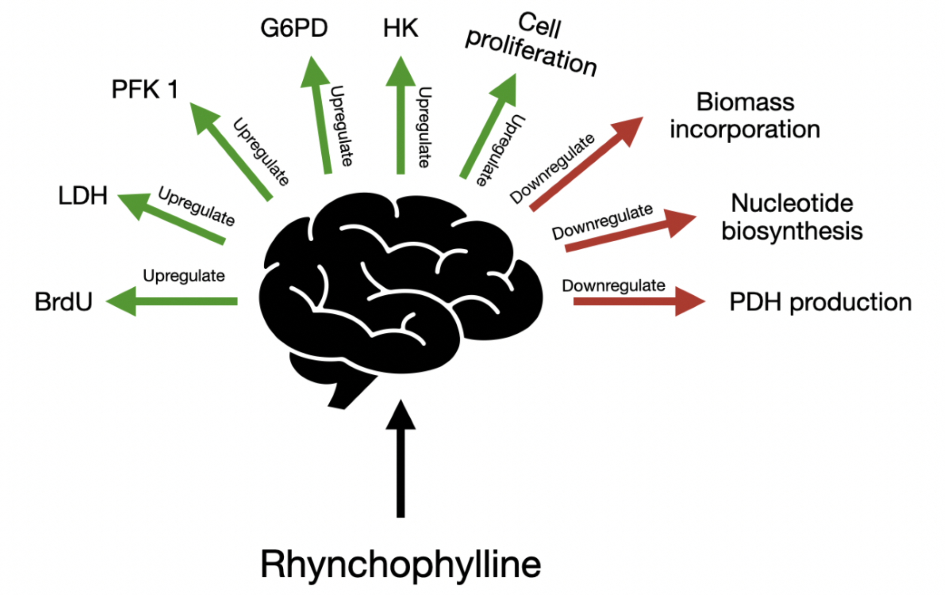
Figure 1. Rhynchophylline affords its therapeutic effects through multiple mechanisms, including upregulation of BrdU, LDH, PFK1, G6PD, HK and cell proliferation, while downregulation biomass incorporation, nucleotide biosynthesis, and PDH production.
Cozene et al., Conditioning Medicine 2020; 3(4):192-198.

