Slide 1
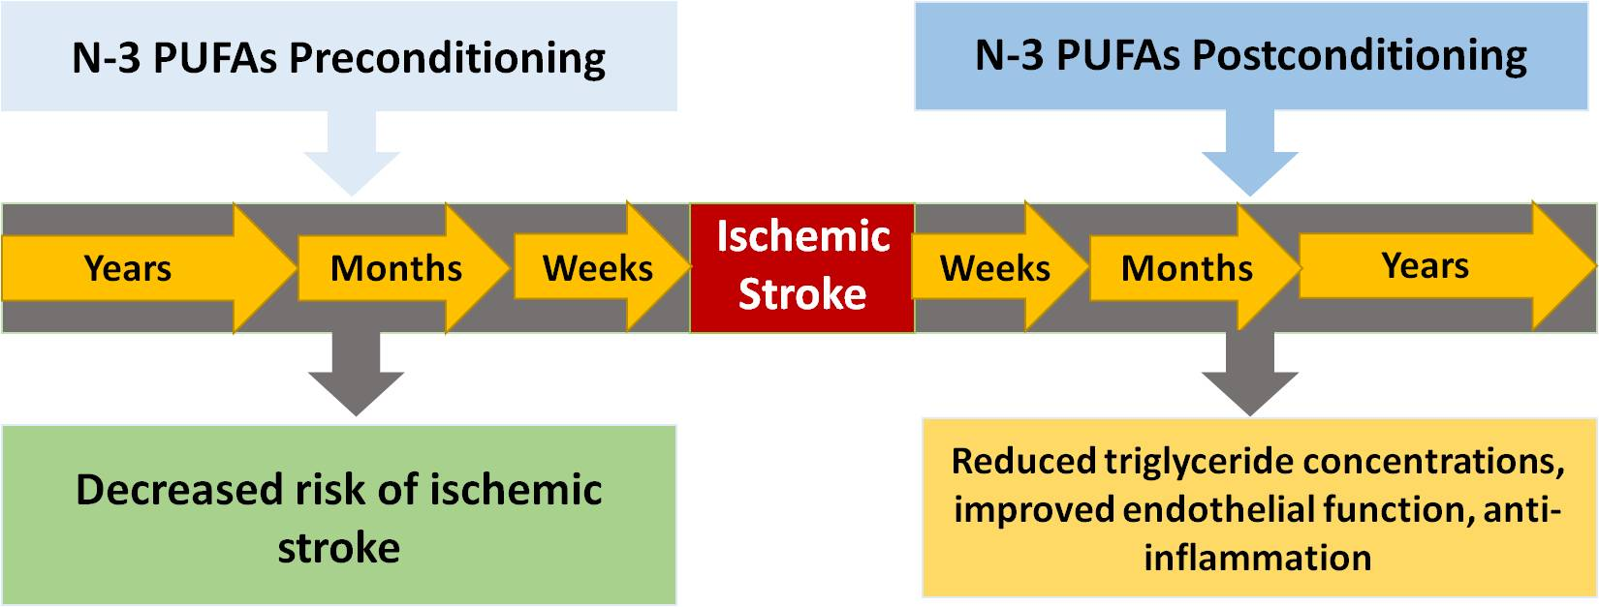
Figure 2. Timeline of n-3 PUFA conditioning before (preconditioning) or after (postconditioning) ischemic stroke and potential outcomes.
Shi et al., Conditioning Medicine 2019; 2(4):152-163.

