Slide 1
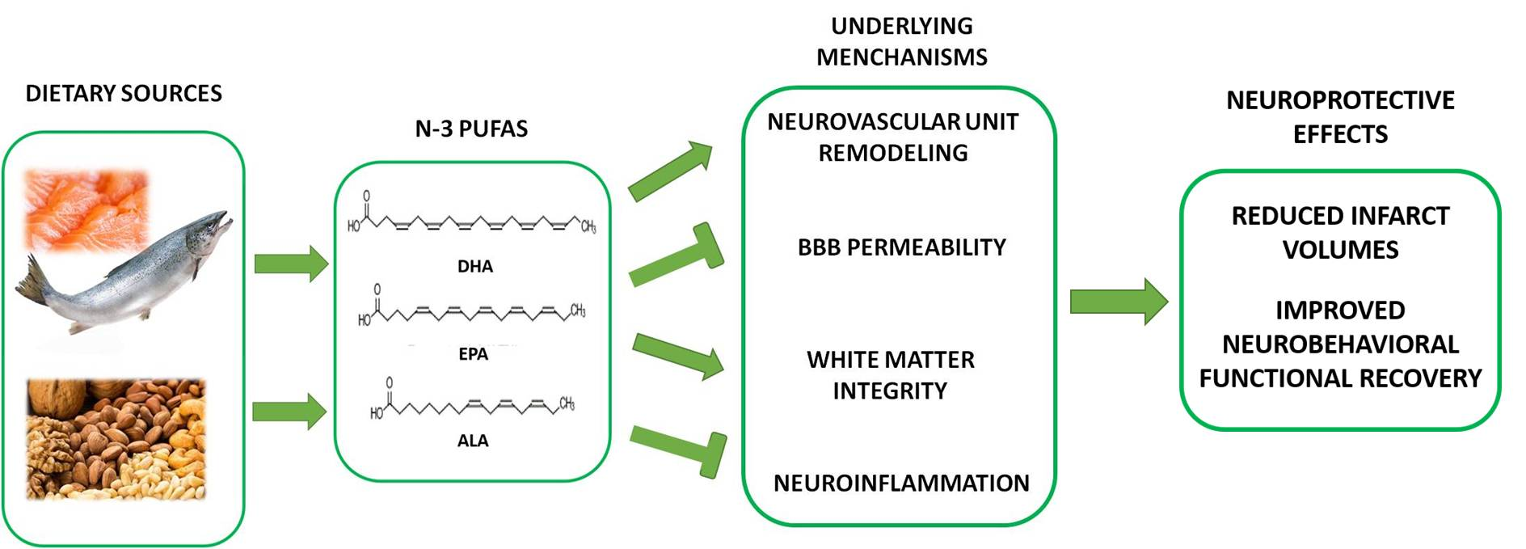
Figure 1. Schematic outline of the mechanisms underlying n-3 PUFAs-mediated neuroprotective effects against ischemic stroke.
Shi et al., Conditioning Medicine 2019; 2(4):152-163.

