Slide 1
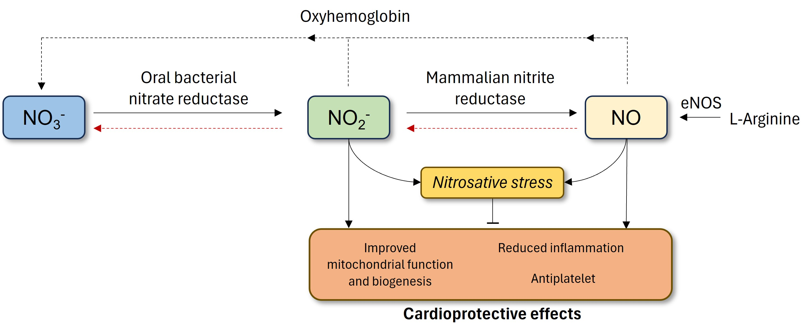
Figure 1.
Lau et al., Conditioning Medicine 2023; 6(4): 131-137.

