Slide 1
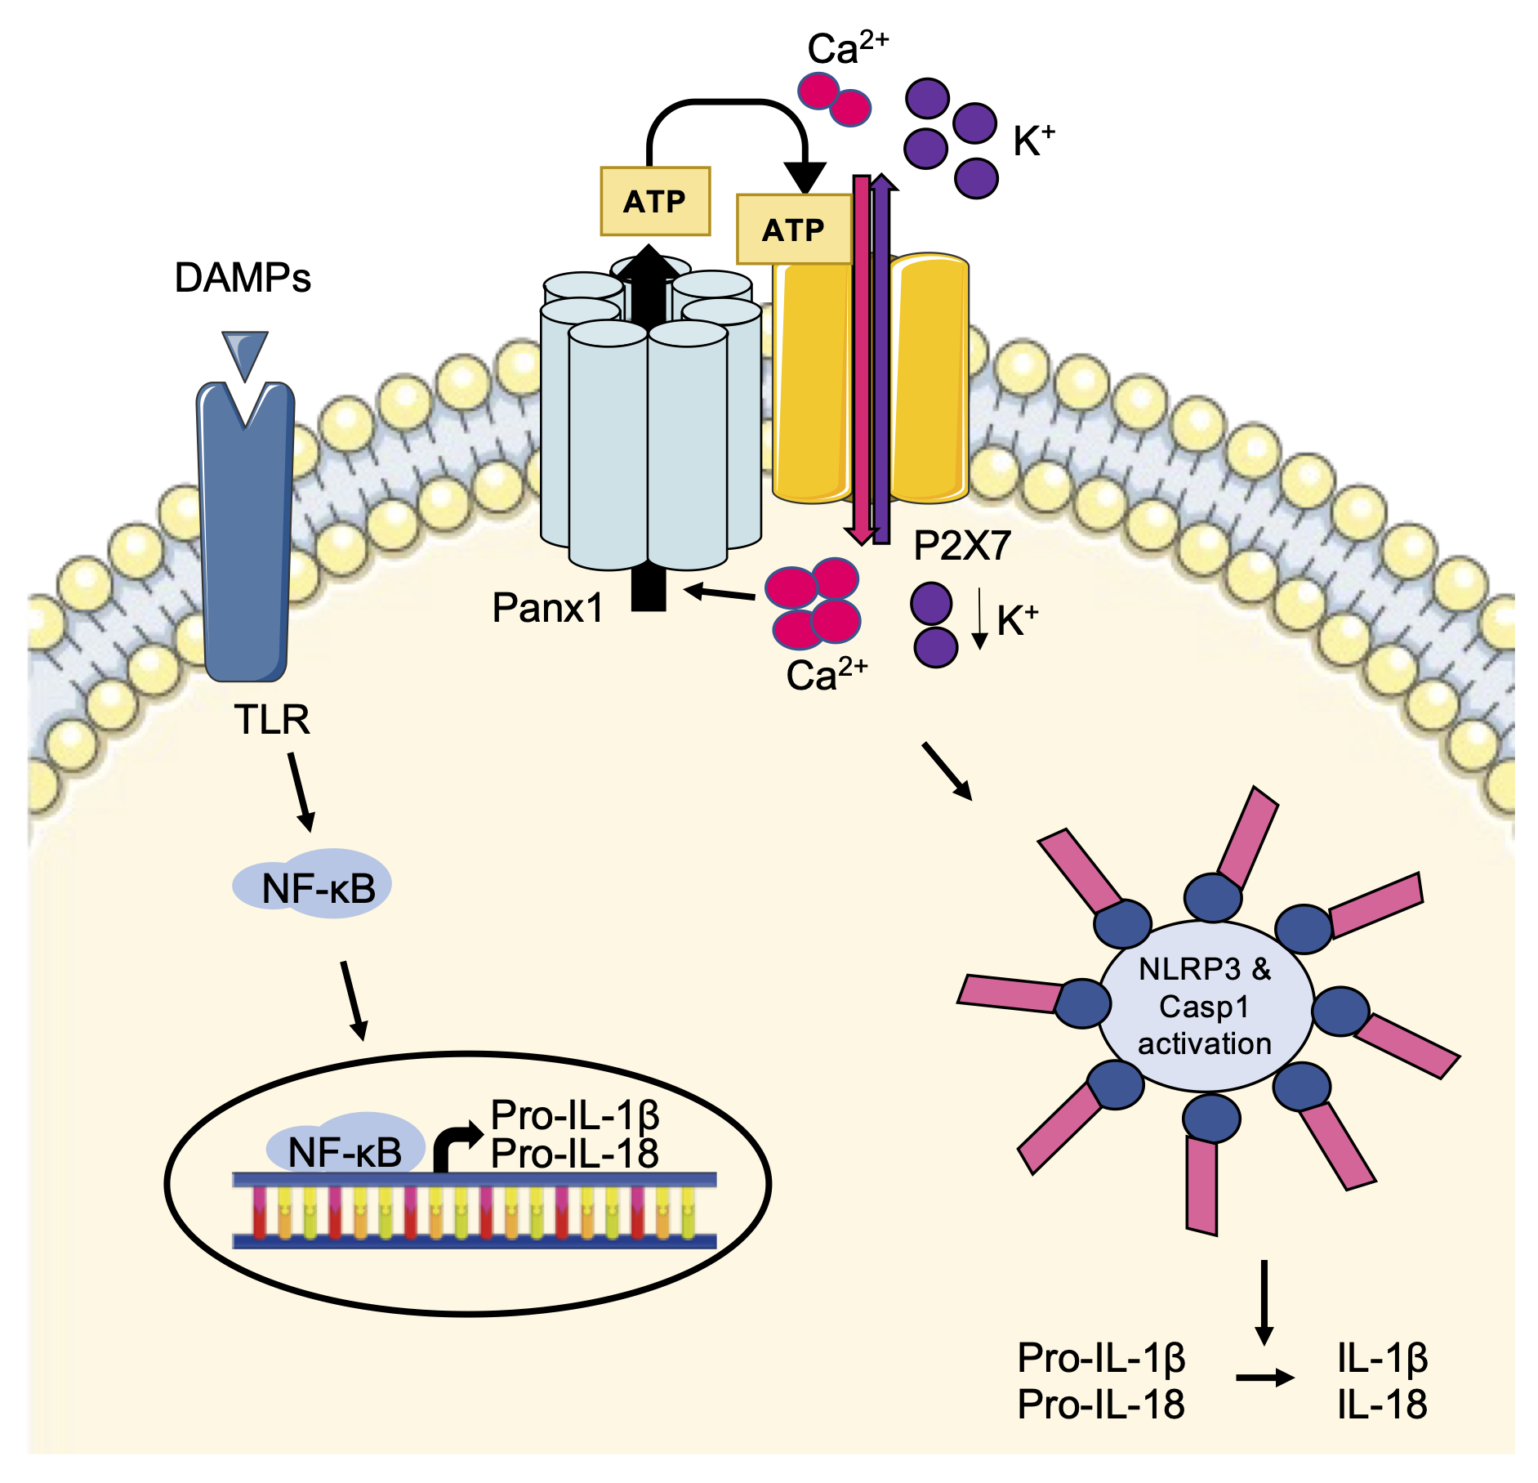
Figure 1.
Tournier et al., Conditioning Medicine 2022; 5(4): 123-130.

