Slide 1
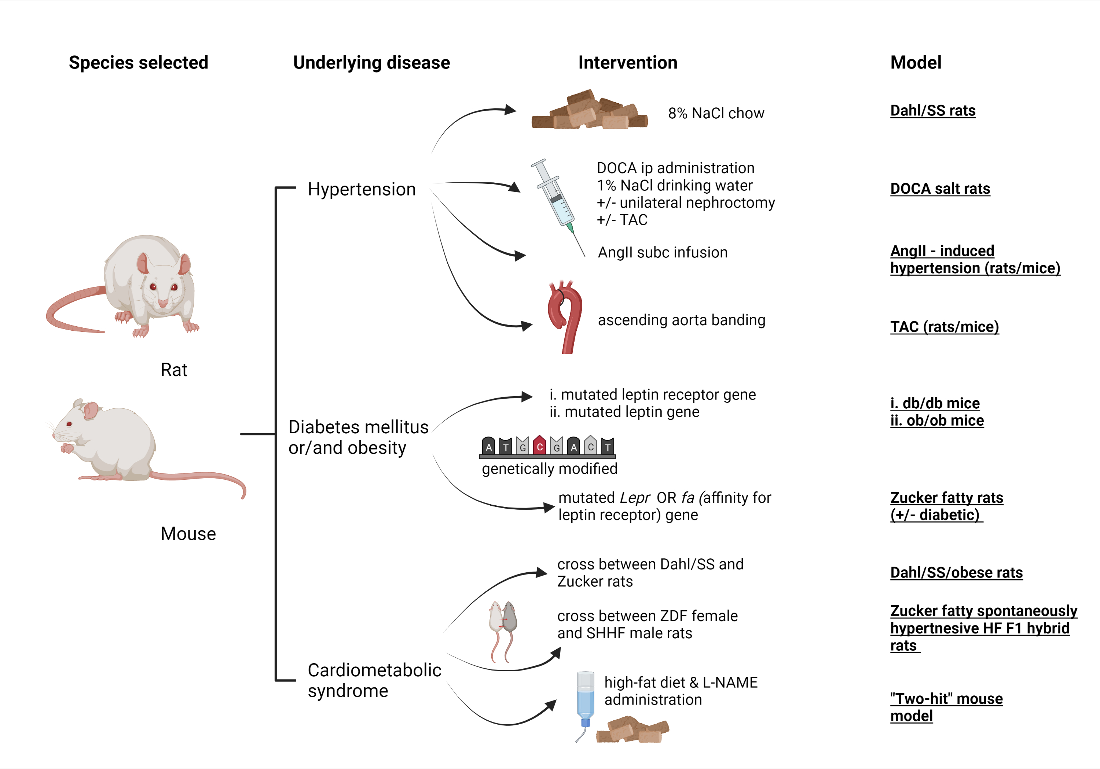
Figure 2. Schematic diagram of the referred HFpEF rodent (mice, rats) models, including species (1st column), main comorbidity (2nd column), stressor for induction of the disease (3rd column) and commonly used name of the model (4th column).
Theano Dermintzoglou and Ioanna Andreadou, Conditioning Medicine 2021; 4(4):168-184.

