Slide 1
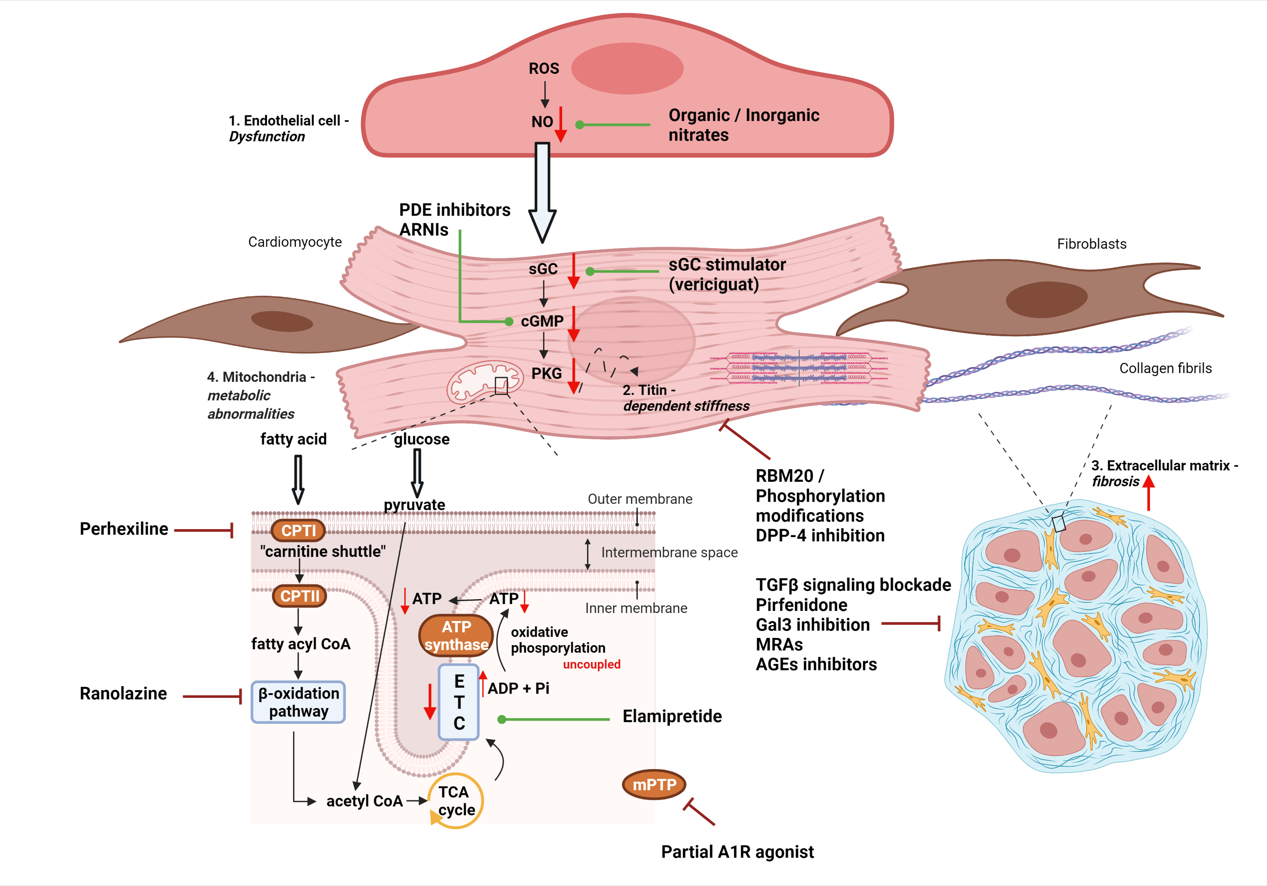
Figure 1. Schematic representation of four main pathomechanisms (See respective modules) contributing to HFpEF development.
Theano Dermintzoglou and Ioanna Andreadou, Conditioning Medicine 2021; 4(4):168-184.

