Slide 1
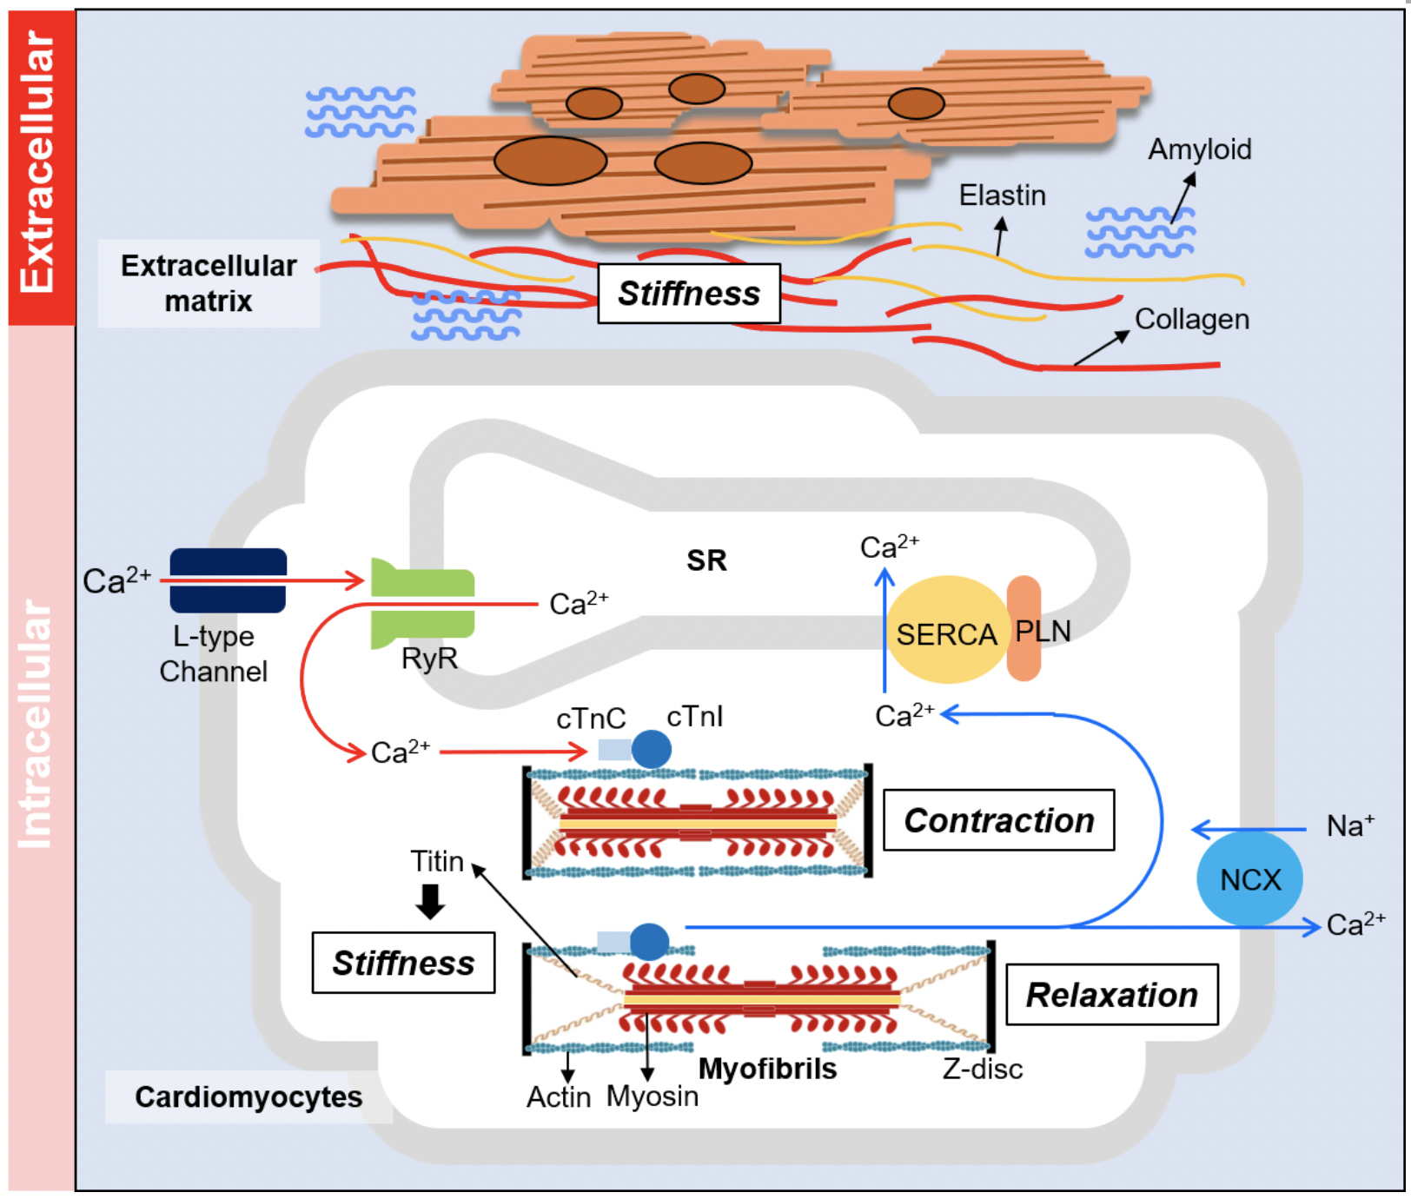
Figure 2. Determinants of myocardium relaxation. Diastolic function of the heart is governed by the stiffness of the myocardium as well as the relaxation action of the contractile unit.
Ying-Hsi Lin et al., Conditioning Medicine 2020. 3(3):171-183.

