Slide 1
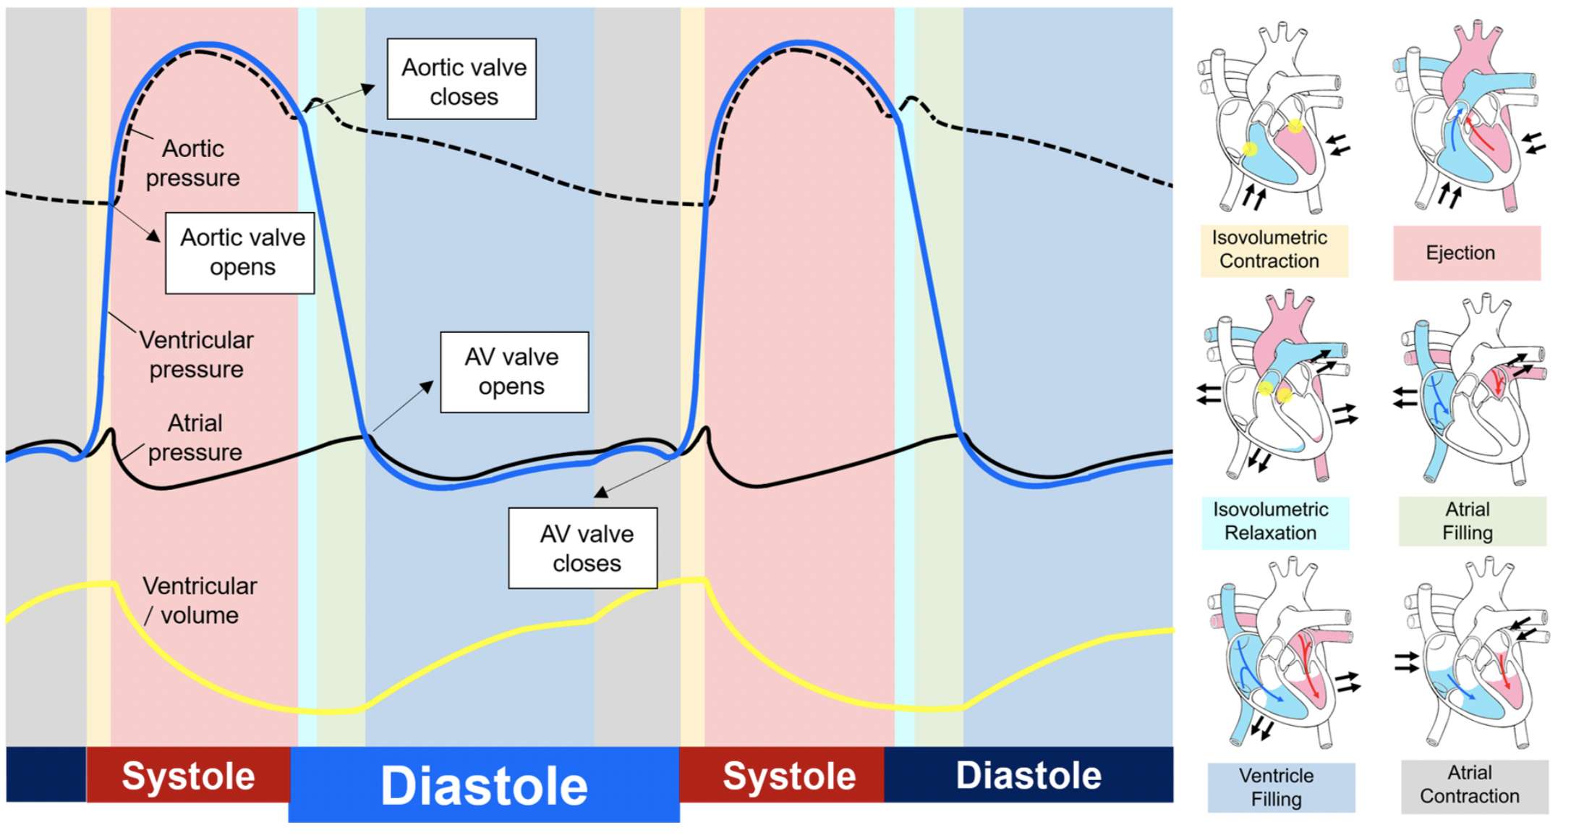
Figure 1. Wiggers diagram and cardiac cycle.
Ying-Hsi Lin et al., Conditioning Medicine 2020. 3(3):171-183.

